Slide 1
Intro to Assignment Groups

Slide 2
Assignment groups

Slide 3


Overview
Assignment Groups are shared pools of user tasks. These groups house tasks that are similar in function or occur in related recovery steps.
Assignment Groups enable teams to achieve production goals by keeping work volumes healthy, ensuring compliance, and organizing tasks to complement analyst skills.
Assignment Groups that contribute to recovery are a part of the Primary Workflow.
Primary Workflow
Exclusion List

Slide 4
Primary Workflow
Daily Maintenance
Assignment Groups that contribute to recovery are a part of the Primary Workflow. These tasks precede and follow recovery.
If earlier tasks in the resolution process miss their deadline, they will move to Assignment Groups handling later stages in the dispute lifecycle.
Provisional Credit
Next Recovery Deadline
Late Lifecycle
Final Reg Deadline
Past Recovery/Reg Deadline

Slide 5
Primary Workflow
Daily Maintenance
Provisional Credit
Next Recovery Deadline
Late Lifecycle
Final Reg Deadline
Past Recovery/Reg Deadline

Slide 6
Other Assignment Groups
There are Assignment Groups that do not contribute to recovery. This means recovery steps can be completed without these tasks being worked.
Some of these groups are optional and therefore their presence is based on configuration.
OOTB
Configurable
Daily Critical
Unworkable
Non Reg
High Dollar

Slide 7
Prioritization
In the Primary Workflow, tasks are assigned based on how soon the dispute will reach its next deadline. The deadlines are driven by regulatory requirements and association guidelines.
This prioritization helps to maintain compliance by prompting analysts to work on the most pressing assignments first.
Other Assignment Groups have various prioritization methods that will be covered in their sections.

Slide 8


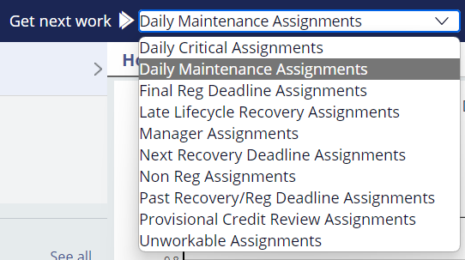

Getting Work Done
Analysts will be assigned casework through Assignment Groups.
1. Select the Assignment Group to work in
2. Click the Get next work button to have QFD assign a task to you

Slide 9
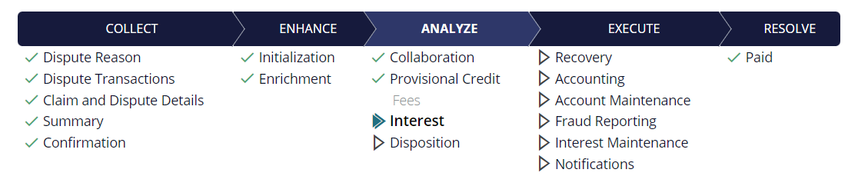
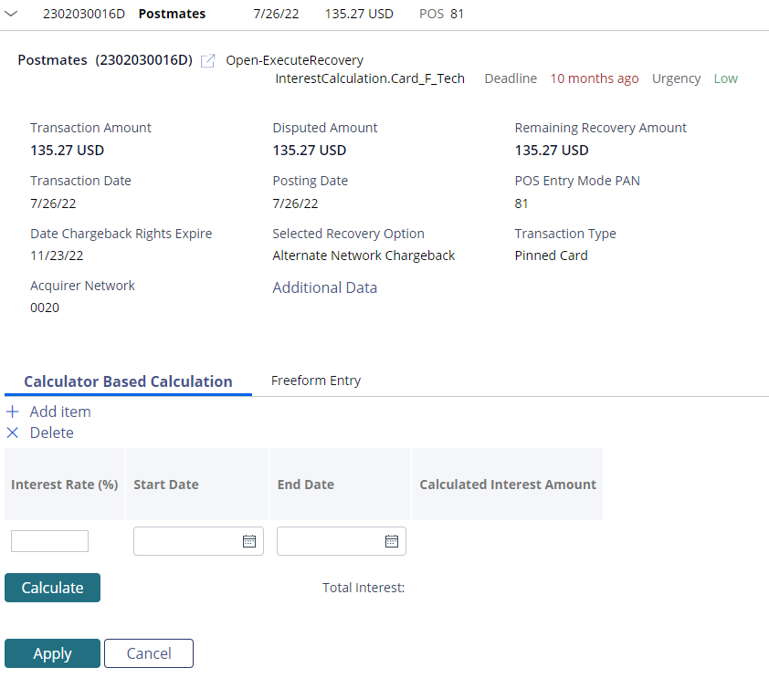
Getting Work Done
The analyst is presented with the specific task assigned to them.
After completing the task, the analyst can close out of the claim and click Get next work to move on to the next assignment.

Slide 10
Primary Workflow

Slide 11
DAILY MAINTENANCE

Slide 12
Daily Maintenance
Daily Maintenance assignments are common tasks that can be assigned to most users because these assignments do not require an investigation.
Check to see if the merchant posted a refund for the disputed charge
Review a pending charge to see if it’s posted to the account
Look at documentation the account holder sent in via email

Slide 13
Key Assignments
Authorization Review: QFD checks to see if a pending disputed transaction has posted every 6 hours for five days. If the posting is not found or is a partial match, an analyst will complete the review.
Enrichment: QFD will make a call to the network to get transaction data that will assist in the investigation. Analysts will enter any required information into QFD.
Documentation: If documentation is required from the account holder, this task will need to be fulfilled. An analyst will review the document received by the account holder.
Check for Merchant Credit: QFD checks for a refund that is promised by the merchant through the Verifi/Ethoca check or has located a credit that matches the disputed charge. An analyst will apply the refund to the disputed transaction resulting in a denial.
Responses: An analyst will review inbound correspondence from the account holder or notes from an intake specialist.

Slide 14
PROVISIONAL CREDIT REVIEW

Slide 15
Provisional Credit Review
Provisional Credit Review assignments are reg-bound provisional credit issuance tasks. Analysts can write-off, deny, or pend the dispute as a part of this assignment.
Grant provisional credit

Slide 16
NEXT RECOVERY DEADLINE

Slide 17
Next Recovery Deadline
Next Recovery Deadline assignments involve preparing and submitting the chargeback or pursuing recovery. This group is focused on initiating the recovery process.
Manually reporting fraud
Selecting the recovery reason
Correcting and completing the chargeback form

Slide 18
Key Assignments
Fraud Reporting: Reporting fraud is executed on fraud card claims. Fraud reporting occurs immediately after enrichment or when one of the following actions are initiated: chargeback, deny, write-off. An analyst will need to complete fraud reporting manually if the disputed transaction was manually added or a part of an alternate network.
Disposition Case: Chargebacks are submitted and managed as part of this task. This includes write-offs and denials, and requesting information from the account holder.
Execute Chargeback: An analyst will need to manually complete the case filing if the disputed transaction was manually added or a part of an alternate network.

Slide 19
LATE LIFECYCLE RECOVERY

Slide 20
Late Lifecycle Recovery
Late Lifecycle Recovery tasks include post-chargeback case work.
Review merchant documents
Make write-off and deny decisions
Manually update the case filing

Slide 21
Key Assignments
Review Dispute Response: The merchant has responded to the chargeback on Visa disputes. Analysts will review merchant documents to determine next steps.
Review Representment: The merchant has responded to the chargeback on Mastercard claims. Analysts will review merchant documents to determine next steps.
Review Pre-Arbitration: Pre-arbitration was initiated, and the Acquirer has responded. Analysts will review the merchant’s response to determine next steps.
Review Arbitration: Arbitration was initiated, and the Acquirer has responded. Analysts will review the merchant’s response to determine next steps.

Slide 22
Other Assignment Groups

Slide 23
Daily Critical

Slide 24
Daily Critical
Daily Critical tasks include failure resolution and exception work. These tasks typically require access to an external system where manual accounting adjustments can be made, and cards/accounts can be closed and reissued/reopened.
Manual accounting adjustments
Block/reissue card
Credit Bureau reporting

Slide 25
Key Assignments
Block/Reissue Card: An analyst is prompted to use an external system to block/reissue the card.
Execute Accounting: An analyst is prompted to use an external system to complete the accounting adjustment.
Letter Failed to Send: The letter or email could not be sent using QFD. An analyst is prompted to use an external system or follow internal guidelines to send the correspondence.
Set Amount in Dispute: An analyst is prompted to place the account into a dispute status.

Slide 26
Prioritization
Daily Critical tasks are assigned based on the task due date which varies. Assignments carry different due dates because of compliance and regulatory requirements.
Task | Deadline
Block/Reissue Card | Contact date
Execute Accounting | Same day as accounting adjustment
Letter Failed to Send | Contact date
Set Amount in Dispute | Contact date

Slide 27
Unworkable

Slide 28
Unworkable
Unworkable tasks involve a reported technical issue or system error.
Analysts can mark a task as Unworkable using the Other Actions menu.
Managers will review the task, attempt to resolve the assignment or replicate the task, and escalate the issue to Quavo if needed.
Unworkable tasks are assigned based on the task due date, which varies. Assignments carry different due dates because of compliance and regulatory requirements.

Slide 29
Manager

Slide 30
Manager
Manager Approval tasks are only available when configured. All provisional credit issuances, write-offs, and denials over a specified dollar amount are present in this group.
Managers will review the analyst’s decision and either approve or deny the action.
Manager Approval tasks are assigned based on the task due date, which varies. Assignments carry different due dates because of compliance and regulatory requirements.

Slide 31
Non reg

Slide 32
Non Reg
Non Reg tasks include all claims not protected by Regulation E/Z. Because this assignment group reflects all tasks, users who work in this group must be trained to work all assignments..
Non Reg tasks are prioritized by the oldest claim date.

Slide 33
High dollar

Slide 34
High Dollar
High Dollar tasks are only available when configured. All casework on claims over a certain dollar amount are present in this group.
Analysts who work in this group must be trained to work all assignments.
High Dollar tasks are assigned based on the task due date which varies. Assignments carry different due dates because of compliance and regulatory requirements.

