Slide 1
QFD Overview
Notes:
Purpose: This training aims to familiarize the learners with QFD’s front-office and back-office portals. The facilitator must use both the module and a QFD environment to deliver a comprehensive learning experience.

Slide 2
GOALS
Understand the purpose of QFD
Know how the claim intake process is handled in QFD
Be familiar with QFD’s online portal
Recognize case worker functionalities and user interface
Appendix
Notes:
Tell: At the end of this module, we’ll understand the claim intake process and know the functions available to back-office case workers.

Slide 3
QFD
Notes:
Tell: We’ll start with general information about QFD.

Slide 4
ABOUT QFD
Built for issuers, developed for users. Quavo's experts developed a cloud-based chargeback management software that features automated workflows, assured compliance, seamless digital banking integrations, and continued support after onboarding.
Support issuers
Automation
User experience
Compliance
Notes:
Note: 1 mouse-click for an animation
Action: Request a learner to read the summary, then a second learner to read the bolded words.
Tell: Let’s focus on the words that pop out to us. (click) QFD supports issuers, which are the financial institutions that initiate the dispute or chargeback. Acquirers are the merchant banks that received the chargeback notice.
QFD incorporates automation for a swift dispute resolution. Part of this automation is ensuring that all regulatory requirements are met, keeping everyone compliant. QFD’s user interface simplifies the investigation leg of the dispute process by consolidating all required info in one spot.

Slide 5


QFD ENVIRONMENTS
Front Office
Back Office
Notes:
Tell: QFD has two work portals: front-office for claim intake specialists and back-office for dispute resolution specialists. We’ll start with the claim intake flow in front-office.

Slide 6
CLAIM INTAKE – Front OFFICE
Notes:
Tell: Claim intake is commonly referred to as “front-office”. Front-office workers can be call center representatives or entry-level dispute specialists, depending on the financial institution’s workforce. Because those who capture dispute claims can have a diverse range of knowledge, the claim intake process is simple and concise.
Ask: Who’s had to submit a dispute with their bank before? What was the experience like?

Slide 7

FRONT OFFICE
The claim intake process in QFD is designed to allow generalists to submit a dispute claim efficiently.
Anyone can fill-out a claim
Questions are driven by the Association
Notes:
Note: 1 mouse-clicks for animations
Action: Request a learner to read the summary.
Tell: Homing in on the bolded words, (click) QFD supports generalists, meaning anyone can successfully submit a claim in the front-office portal. We’ll come to see that the questions asked in the questionnaire are driven by Mastercard and Visa chargeback requirements. Ideally, the information will be captured correctly in intake which will result in the dispute being processed automatically.

Slide 8
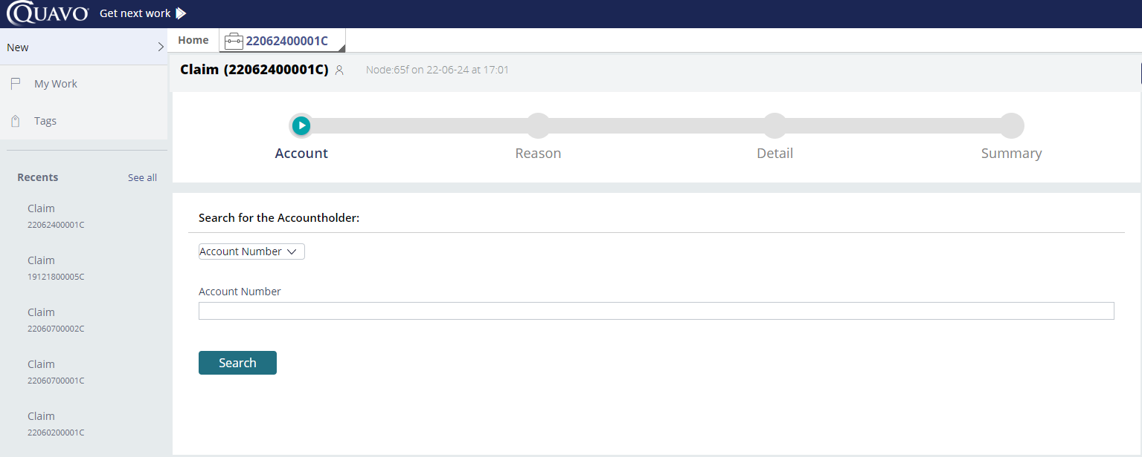
FRONT OFFICE
Notes:
Note: 3 mouse-clicks for animations
Tell: We begin on the home screen in the front-office portal. To initiate a new dispute claim, we’ll click on New (click). Here’s a our fresh, new unsubmitted claim. Know that the first six digits of the claim number represent the date the claim was initiated. (click) Here are the stages of claim intake. We’ll first start by pulling up the cardholder’s account (click). We can search by card number, account number, member name, and so on.
Action: In the QFD environment, create a claim and show the search options. Select a dumby account and then return to the PPT.

Slide 9
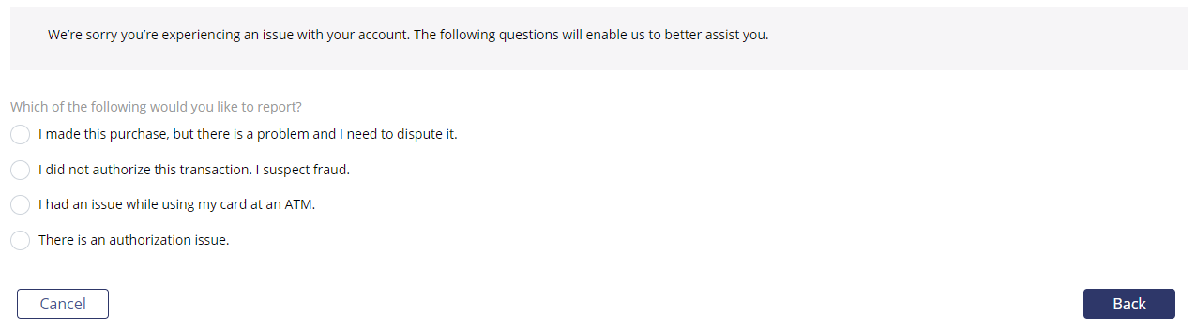
FRONT OFFICE
Non-fraud
Fraud
ATM
Notes:
Note: 1 mouse-click for animation
Tell: We’ve moved onto the second stage of claim intake. The first question determines what type of claim is being filed (click) non-fraud, fraud, or an ATM issue. The questionnaire will populate additional questions based on this selection.

Slide 10
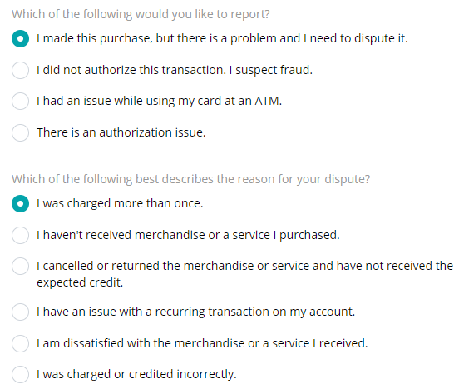
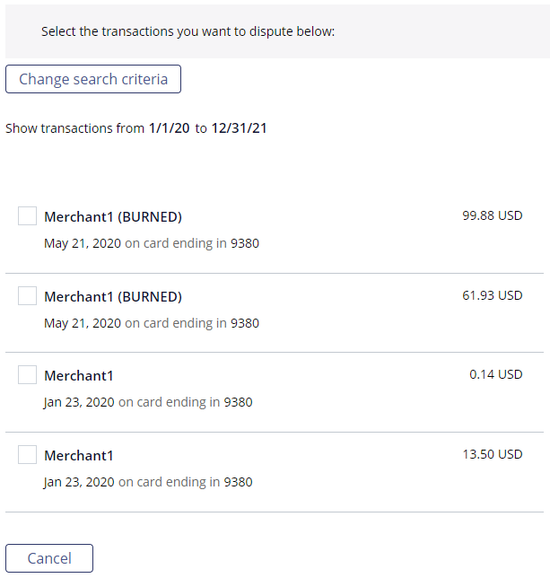
FRONT OFFICE
Notes:
Note: 2 mouse-clicks for animation
Tell: (click) Now we’re getting more information. If you’re familiar with association nomenclature, you may notice that these questions are dispute reasons. Again, the intake process will support automated dispute resolution, including chargebacks, when done correctly.
Action: In the QFD environment, answer the first questionnaire question with “I made this purchase…” then select “I was charged more than once”. Move on to the next screen and select a transaction. Return to the PPT.
Tell: (Click) QFD defaults to a two-week window when displaying transactions. Updating the range will allow us to select transactions that occurred further back. At this point in the life of a dispute, the specialist should not be considering chargeback rights, therefore, they should move forward with the claim even if the disputed transaction is stale.
We can manually add a transaction if it doesn’t show in the search, however, this can impact automation and require more manual work on the claim. Manually adding a transaction should not be used often and the function can be removed per client configuration.
It's important to know that the dispute reason (charged more than once, merch/service not received, etc.) can impact the transaction selection. For example, duplicate processing won’t let you choose more than on transaction to reduce user error.

Slide 11
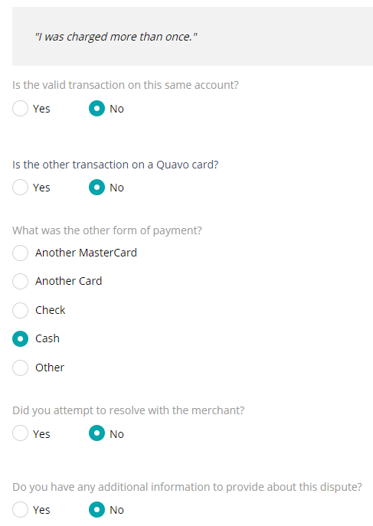
FRONT OFFICE
Notes:
Note: 2 mouse-clicks for animation
Tell: (Back in the PPT) (click) Now we’re in the Details stage of the claim intake process. We have a few questions to answer based on the claim and dispute reasons. These questions are non-configurable because they’re designed to capture the information needed for chargebacks upfront. Clients can add a request for police report information.
Action: Complete the questionnaire in the QFD environment then return to the PPT.

Slide 12
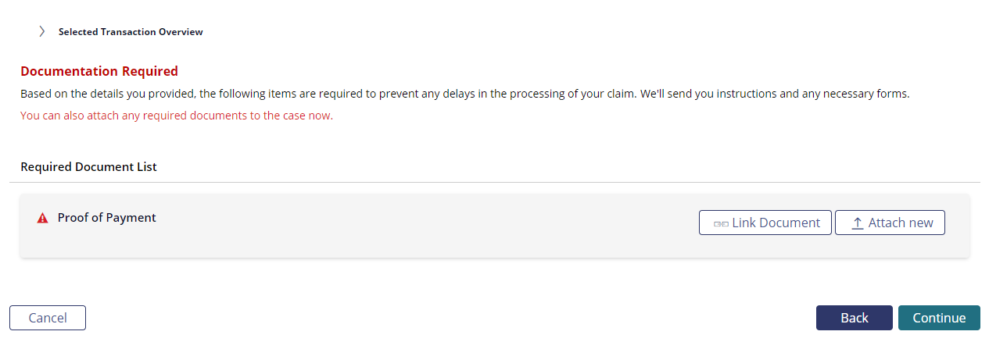
FRONT OFFICE
Notes:
Note: 1 mouse-click for animation
Tell: Now that the questionnaire has been completed, we can wrap-up the claim. QFD will require documentation in some cases, such as requiring proof of paid by other means. (Click) the cardholder can provide the document to the intake specialist now or submit the document later. Methods of submission include responding to any claim-related email correspondence, emailing the client bank, or uploading the document directly to the online banking portal (if QFD bank integration is enabled).

Slide 13
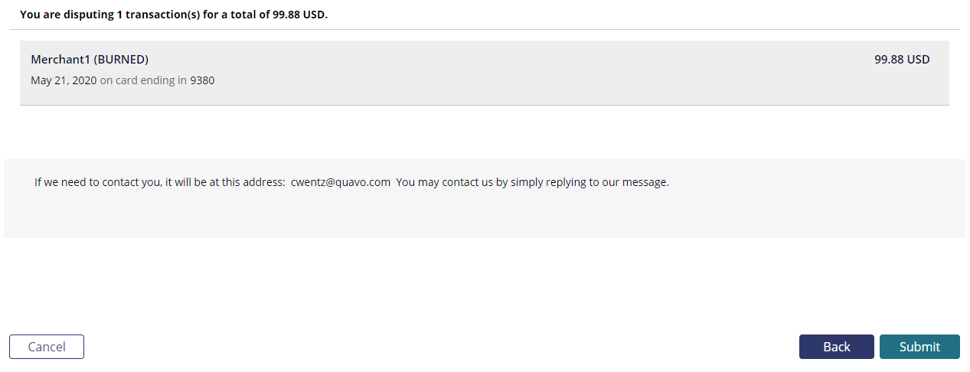
FRONT OFFICE
Notes:
Tell: The Summary screen is the last we’ll see before the case is filed. We’ll review the details of the claim with the cardholder before submitting. If needed, we can click the Back button to return to any prior screen to edit the claim. Before case filing, we’ll confirm the cardholder’s correspondence channel, which defaults to email. Some clients have enabled the ability to change the email and communication method. If a client doesn’t have this function enabled, the information can be updated after the claim is submitted in the back-office portal.
Action: Move through the Documentation Required page and the Summary screen, then return to the PPT.

Slide 14
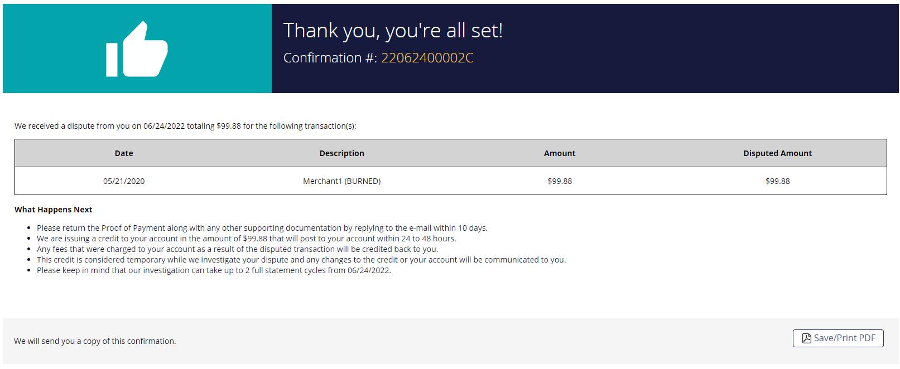
FRONT OFFICE
Notes:
Note: Two mouse-clicks for animations.
Tell: This is the final screen in the intake flow, the Confirmation page. At this point the claim has been submitted and we can provide the confirmation number to the member for reference (click). We’ll go over the What Happens Next section, which is configurable per client. If needed, we can generate the confirmation PDF.
Action: Move to the Confirmation page and generate the confirmation PDF as a demonstration. Return to the PPT.

Slide 15
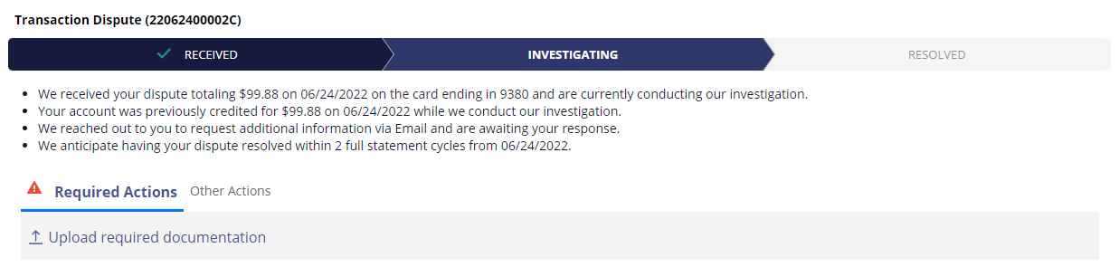
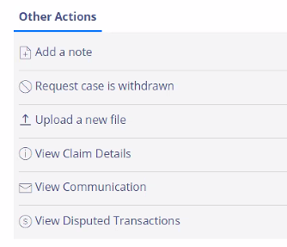
FRONT OFFICE
Notes:
Note: One mouse-click for animation
Tell: Now that the claim has been filed, we can access it in the back-office portal. This is the case status page where front-office specialists can handle inquiries about open cases (click). Intake specialists have tools available to them in the Other Actions tab. They can add a note to the case, which will create an assignment to the back-office investigator. The case can be withdrawn, documents can be uploaded, and the specialist can verify communication sent to the member. Transactions can be added to the existing case if the claim type allows it (examples: fraud claims, certain non-fraud claims such as cancelled recurring)
Action: In the QFD environment, access the submitted claim and navigate to the Case Status. Show the following functions: Add a note, Request case is withdrawn, Upload a new file, View Communication. Return to the PPT.

Slide 16
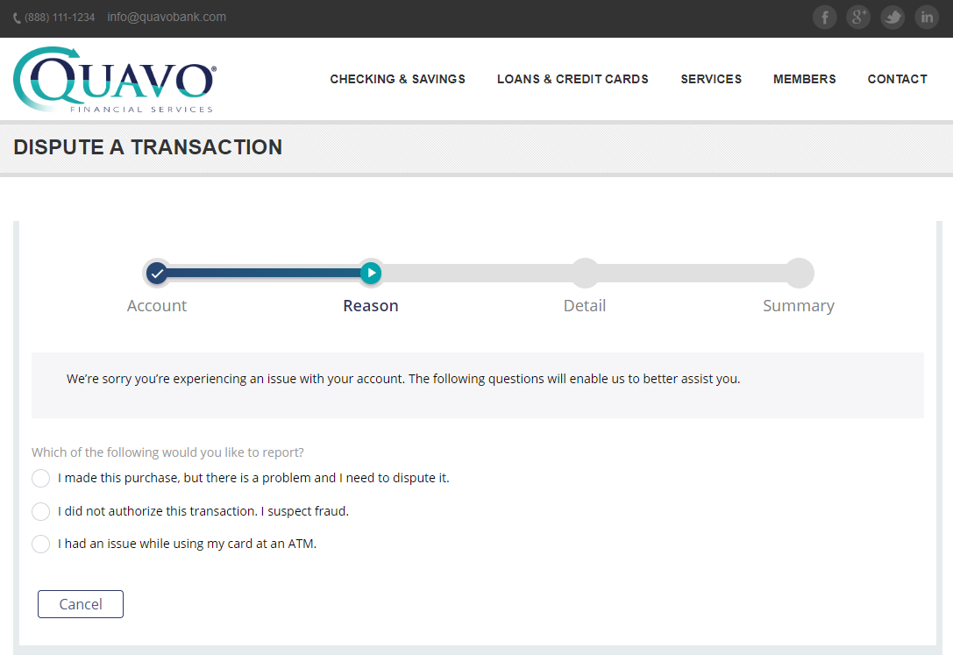
FRONT OFFICE
Online bank integration
Notes:
Tell: Clients can enable QFD integration in their online banking portal. This allows members to submit disputes online at their own convenience. This dispute submission follows the same flow and questionnaire as the front-office claim intake process.

Slide 17
CASE WORK – BACK OFFICE
Notes:
Action: Pause for questions and a stretch break.
Tell: (After returning from the break) Dispute processing and any applicable investigations take place in the back-office.

Slide 18
BACK OFFICE
Case work in QFD ensures compliance and simplifies the complexities of dispute resolution through automation.
QFD is programmed to meet all compliance deadlines
QFD has a user-friendly interface and accessible tools
The client can configure QFD to automatically pay or deny disputes
Notes:
Note: One mouse-click for animation
Action: Request a learner to read the summary.
Tell: (Click) QFD meets regulation deadlines automatically, ensuring clients pass audits. Through customized automated tasks, QFD can make pay or deny decisions without human intervention. That’s not to say that human talent is never needed as getting a real-person review is necessary in many scenarios.

Slide 19
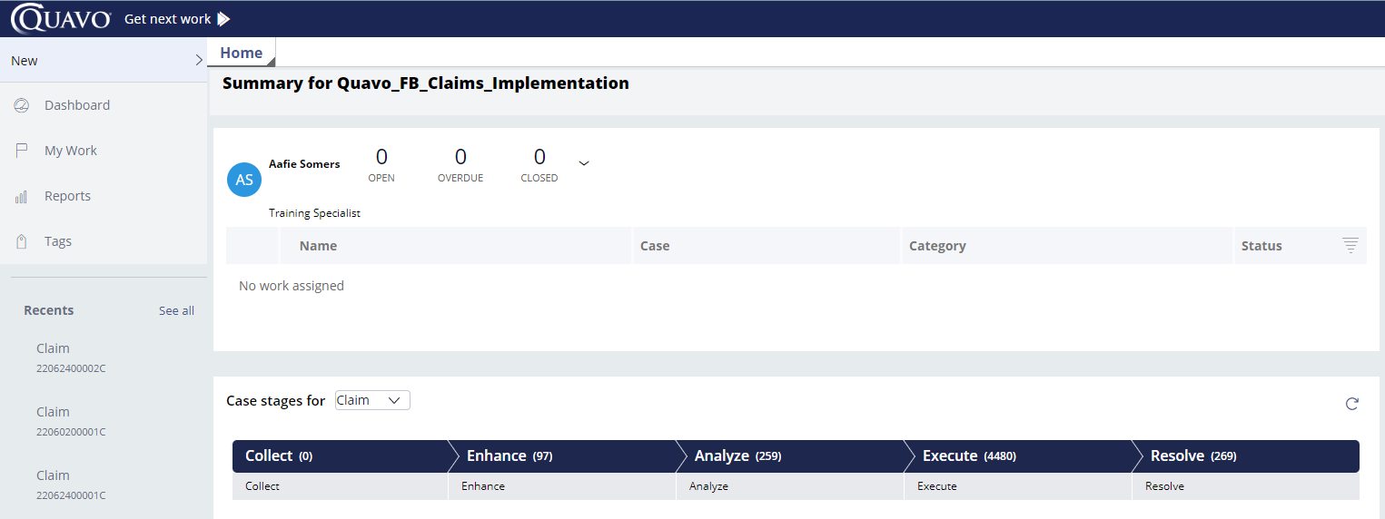
BACK OFFICE
Notes:
Note: Two mouse-clicks for animations
Tell: We land on the back-office home page. There are several functions available to us here. (Click) Clicking on Get Next Work assigns the most urgent claim available, based on the user’s role and permissions set. QFD breaks down dispute tasks and users can have tailored permissions based on their knowledge, experience, and business need. Know that back-office work is denser and more nuanced than claim intake. (Click) We can quickly access recently viewed claims, which is helpful when following-up on a case. Clicking on See All will display the last 30 claims viewed.
Action: In a QFD environment, show the Show All function. The Get Next Work button may not work in a demo environment, so have an in-progress claim available to use for demonstrations throughout.

Slide 20

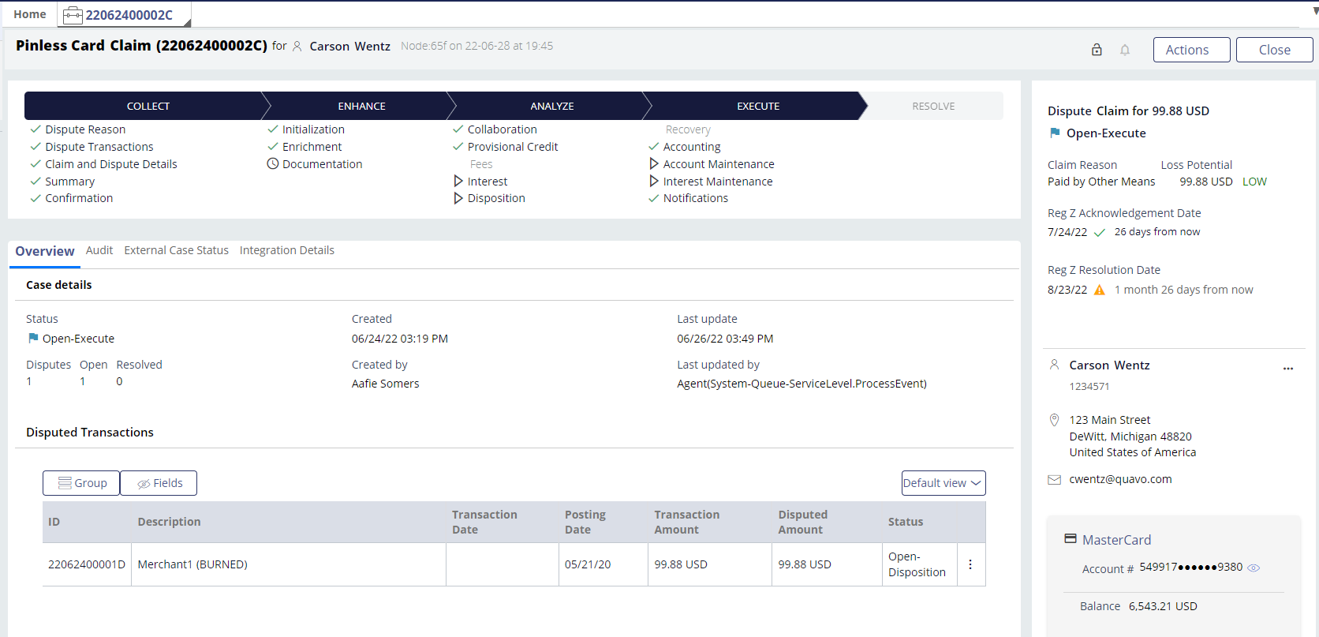



BACK OFFICE
Notes:
Note: Four mouse-clicks for animations
Tell: We’re greeted with a lot of information when we open a claim. Throughout the rest of this module, we’ll be taking a close look at several of these elements: (click) the case heading, (click) the case roll-up, (click) the case assets, (click) and the case tabs.

Slide 21
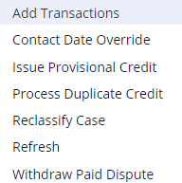
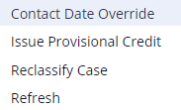
BACK OFFICE
CASE HEADING
The claim lock is valid for 30 minutes after assignment.
Claim number includes the submission date and is the confirmation number
QFD will alert you of suspected claim abuse.
Notes:
Note: Five mouse-clicks for animations
Tell: We’ll start with the case heading. (Click) The claim number is the same as the confirmation number we provided the customer in claim intake. It’s formatted to the day the claim was created in year, month, day 6-digit format.
(Click) On the right you’ll see a lock. The claim will be pulled out of the pool of available assignments once it’s been assigned through Get Next Work. That means that no other specialist will be able to pull this case through Get Next Work, minimizing the possibility of two people working the same claim. A case can be manually locked if no one currently has a lock on it. The lock is active for 30 minutes, which is more than enough time to complete any dispute task. Once the lock has dropped, the claim can be assigned to anyone if it has a task that needs to be completed.
(Click) The bell next to the lock will be red if QFD has identified potential claim abuse. This determination is based on the volume of claims filed recently and the account open date. The back-office specialist will look for characteristics of claim abuse as part of their investigation.
(Click) The Action button provides additional actions that can be taken on the claim. The options available in the Action button menu change depending on where the claim is in the dispute life cycle.
(Click) Finally, the Close button will exit-out of the claim and remove the user’s lock. This is the proper way to close a claim.

Slide 22
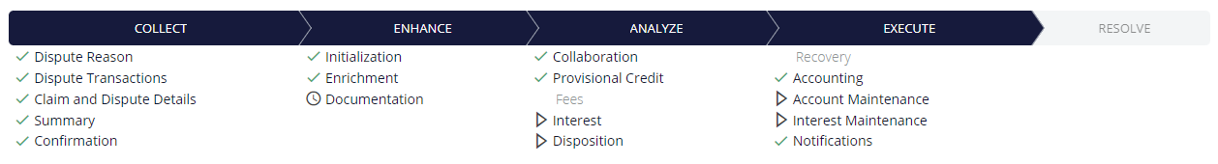
BACK OFFICE
CASE ROLL-UP
Collect the dispute and claim information
Enhance the disputed transaction data
Analyze the claim and determine if a chargeback is needed
Execute recovery tasks and accounting
Resolve the claim through a write-off or denial
Notes:
Action: Five mouse-clicks for animations
Tell: Let’s review the case roll-up. Several sub-tasks are listed under each stage of the dispute resolution process. Although all cases are different, these stages lay out exactly what’s needed to be done to resolve the claim. (Click) At this point, all the tasks under the Collect stage have been completed as part of the claim intake flow.
(Click) In the Enhance stage, we’ll prepare the disputed transaction for the potential chargeback process. QFD allows pended transactions to be disputed so we’ll confirm the posting here. We’ll make calls to the system of record and association to get rich transaction data, which will assist in the investigation.
(Click) The bulk of the investigation will be handled in the Analyze stage. Here, we’ll review for chargeback rights and grant Provisional Credit, if applicable. QFD will seek-out merchant credits and handle fee and interest accounting tasks, which are client configurable in their accounting plan. We can submit the chargeback, pursue recovery, and process liability here, too. Recovery tasks are completely handled within QFD for most clients.
(Click) The Execute stage is all automated and includes the back-and-forth communication between the acquirer and QFD, and accounting tasks.
(Click) The Resolve stage only has two sections beneath it and those are “Denied” or “Paid”, based on how we determined to close the claim.

Slide 23
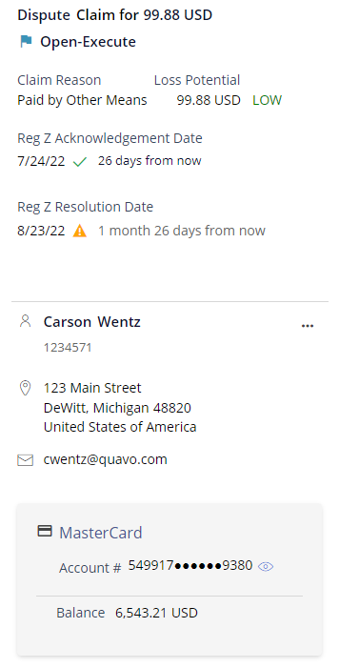
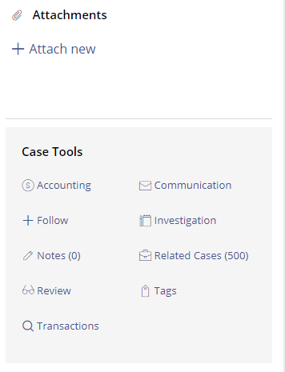
BACK OFFICE
CASE ASSETS
Total claim amount
Claim reason
Regulation dates
Customer info
Account info
Balance
Notes:
Note: Two mouse-clicks for animation
Tell: On the far right of the claim, we’ll see the case assets. (Click) The first section shows the total claim amount, the claim type (fraud or non-fraud), the claim reason (varies by claim type), and the regulation dates. Here we see two Reg Z dates who requirements need to be met within that timeframe.
(Click) In the second section, we have the cardholder’s details. Their name, address, email, and card information will be provided. This information is frozen at the time of case filing, so if the cardholder updated their information after the case was filed, it would not be reflected in QFD. This is to support the investigation because we want to understand what went on at the time of the dispute.
Beneath the cardholder’s information is a place where attachments can be bound to the case. Attachments can be any file type, however, only document file types can be used on a chargeback. Files can be attached by clicking on Attach new.
The last section of the case assets is the case tools hub. We’ll take a close look at the case tools on the following slide.
Action: In a QFD environment, open an existing claim and review the case roll-up – what tasks have been completed so far and what task is required to be completed for that claim to move forward. Next, review the case assets, including case tools if there are notes or related claims. Return to the PPT.

Slide 24
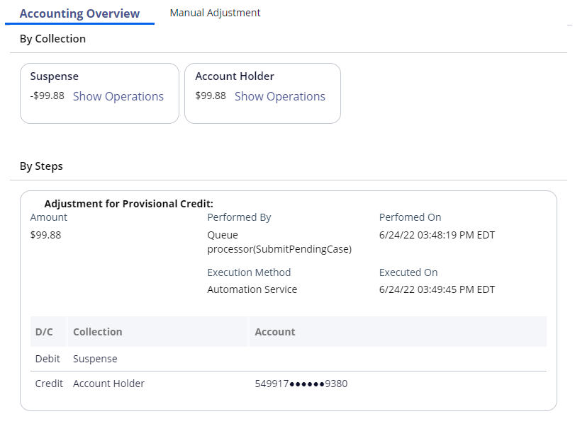
BACK OFFICE
CASE ASSETS
Notes:
Tell: Let’s start with the first case tool, Accounting. The Accounting tool lets us see the money movement in the claim so far. Here we see $99.88 to the account holder and -$99.88 in the suspense account. This indicates that we granted a provisional credit of $99.88 so far. You can see that specific exchange under the By Steps section. The suspense account is used as an intermediary until the claim has been closed and final accounting can be processed by QFD.

Slide 25
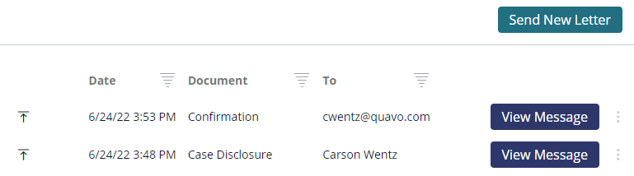
BACK OFFICE
CASE ASSETS
Notes:
Tell: Here’s the Communication hub. We can review prior-sent communications, download them, and send a new letter, if needed. It’s not recommended to create your own letter, however. Letters are baked-into tasks, so for example, as a part of granting provisional credit, QFD would create a letter for our review prior to completing the money exchange. Outgoing correspondence is denoted with the upward arrow on the left. Inbound correspondence would be denoted with a downward arrow.

Slide 26
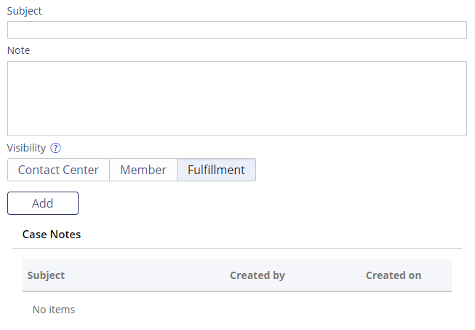
BACK OFFICE
CASE ASSETS
Notes:
Tell: This is the Notes tool. Specialists will notate as part of their workflow. These notes are freeform and do offer sample notes in the QFD Training space in Confluence. Specialists can adjust the note visibility. When requesting information or documentation from the cardholder, we use “Contact Center” which will make the note visible to front-office and general customer service reps. Other notes that are part of the investigation will be under “Fulfillment” which will limit the visibility to only other back-office specialists.

Slide 27
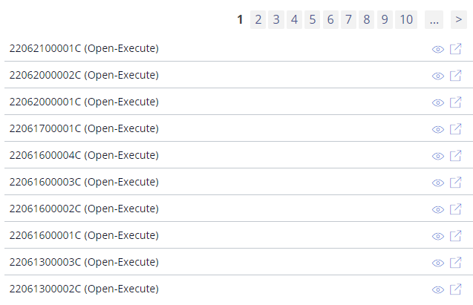
BACK OFFICE
CASE ASSETS
Notes:
Tell: The tool we’ll review is Related Cases. In this example, this cardholder has an astounding amount of cases and is a claim abuser but know that this is a dumby account. It’s important that we have access to related cases as part of our investigation. QFD will hold onto cases indefinitely.

Slide 28
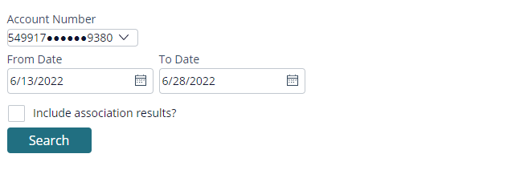
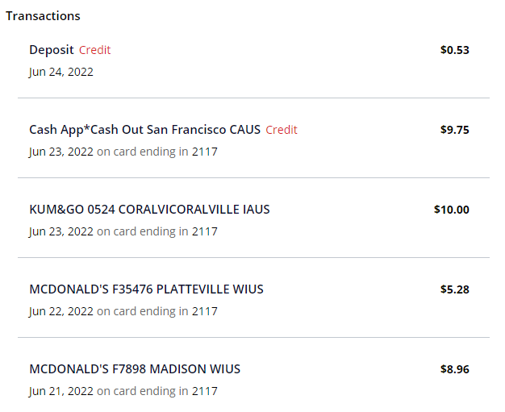
BACK OFFICE
CASE ASSETS
Notes:
Tell: QFD pulls updated transaction information from the system of record. That means that we’ll always have recent transaction data available to us for the investigation.
The Follow tool can be used to save a claim under Recents that will not go away until you un-follow. Investigation is used to capture police report information. Tags can be used to track fraud trends, however, we suggest against this because tags are case-sensitive which can result in inaccurate reporting.
Action: In the claim open in the QFD environment, go through the case tools: show any accounting that’s been done, any letters sent/received under Communication, any notes on the claim, any related claims, and peek at recent transactions. Return to the PPT.

Slide 29
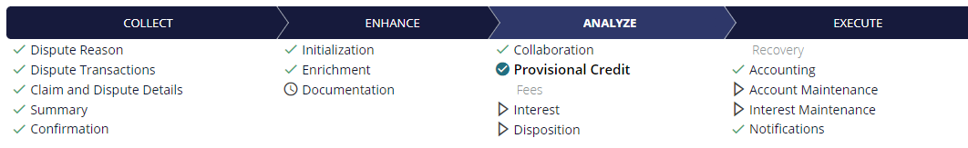
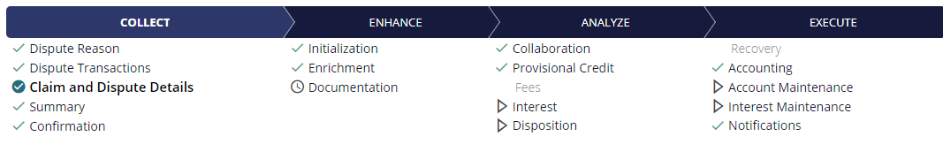
BACK OFFICE
TABS
Notes:
Tell: Before we dive into each QFD tab, I’d like to draw your attention to the first tab. In these screenshots, they’re Provisional Credit and Claim and Dispute Details. The first tab in QFD changes depending on what task you clicked on in the case roll-up. Overview, Audit, Questionnaire, External Case Status, and Integration Details will always be present.
Action: In the claim open in the QFD environment, click on different tasks in the case roll-up to demonstrate how the first tab changes. Return to the PPT.

Slide 30
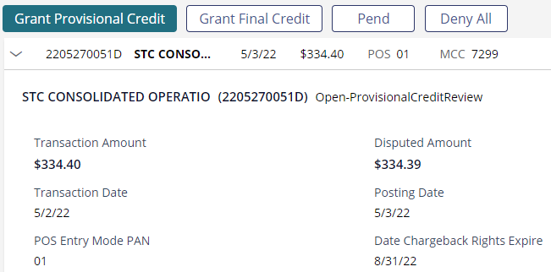
BACK OFFICE
TABS
Notes:
Tell: We know that the first tab changes based on the task we’re on, but let’s start with the Provisional Credit tab. Here, we see the Provisional Credit task is ready to be worked. We have the option to grant PC, pay the dispute, pend the dispute, or deny it.
Action: In the claim open in the QFD environment, show an available task (doesn’t have to be PC but the claim should have a specialist-assigned task). Go over the actions we can take to complete that task. Click on the ellipses on the right side of the task (Other Actions) and show the additional options. Show the task assignment (“.technician” or “.specialist”). That’s how we know the dispute needs a case worker to complete the task vs. QFD automatically running a process. Return to the PPT.

Slide 31
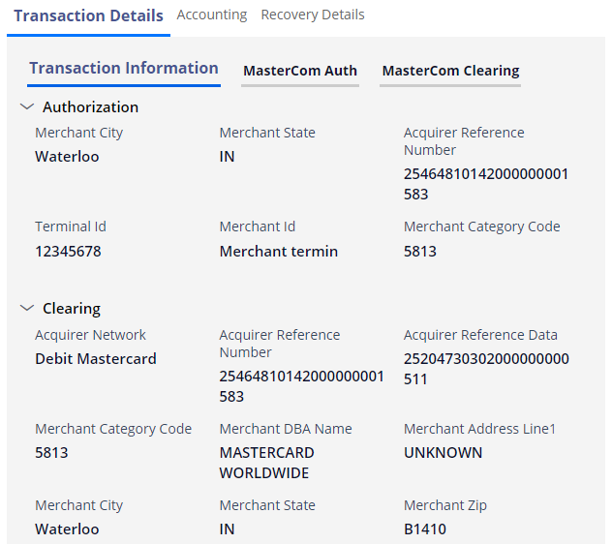
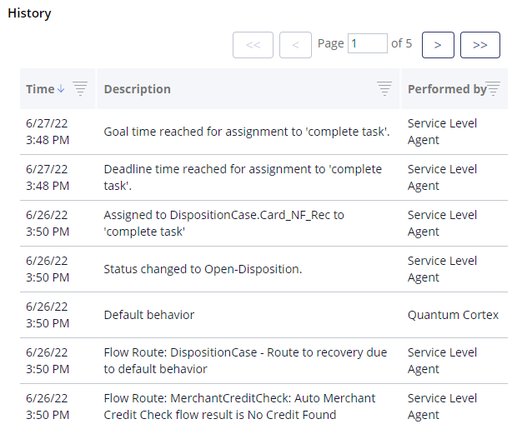
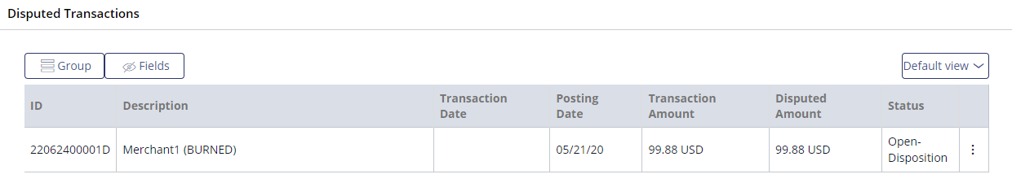
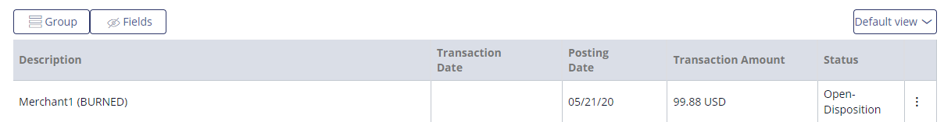
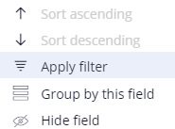
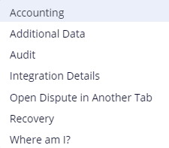
BACK OFFICE
TABS
Notes:
Note: Three mouse-click for animations
Tell: Next, we’re looking at the Overview tab. This displays all the disputed transactions on the claim. We have the option of filtering and organizing the transactions, which is helpful when you have a claim with more than ten disputed charges.
We can also customize the Overview layout to our preferences by hiding some fields. (Click) Here you can see that we hid the ID column and the Disputed Amount column.
We can dig deeper into the disputed transaction by clicking on the ellipses or known as Other Actions. We can check out the transaction’s accounting, its additional transactional data, review the dispute-level audit, amongst other things.
Let’s look at the additional data and dispute-level audit trail. (Click) On the left, we see the additional transactional data. This is where we can review in-depth information on the charge, including protected ECS values and details on how the transaction was processed (if it’s POS 07, how was the transaction processed – mobile wallet or physical card).
On the right, we see the dispute-level audit trail. QFD captures every action taken on this dispute, including automated decisions.
Action: In the claim open in the QFD environment, walk through the Additional Data available on a transaction in the Overview tab, moving through Transaction Details, Accounting, and Recovery Details. Then review the dispute’s audit trail. Return to the PPT.

Slide 32
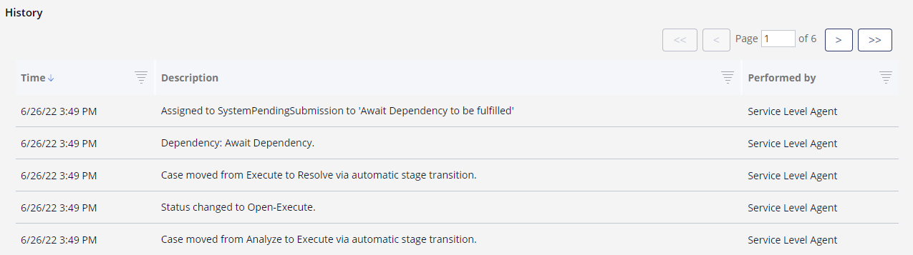
BACK OFFICE
TABS
Notes:
Tell: Next we’ll review the claim-level audit. The claim-level audit differs from the dispute-level audit because the claim audit captures the movement of the claim and actions taken on the disputed transactions, whereas the dispute audit is specific to that transaction and has more data on its movement.
When reviewing the audit, be mindful of the three columns that reflect the timestamp, the description, and who completed that action. In this image, all the actions were taken by QFD, but if an agent touched the dispute, their first and last name would be captured in the last column.

Slide 33
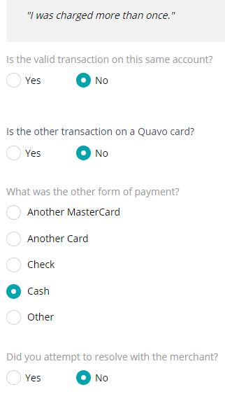
BACK OFFICE
TABS
Notes:
Tell: In the Questionnaire tab, we can see how the questionnaire was completed in claim intake. We can see the same information in the Claim and Dispute Details task in the case roll-up.

Slide 34

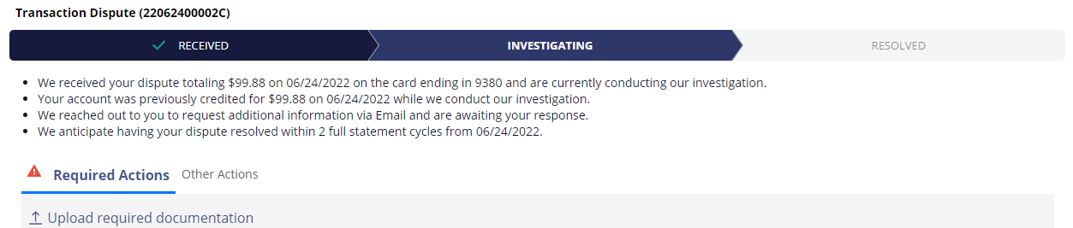
BACK OFFICE
TABS
Notes:
Tell: Finally, in the External Case Status tab, we can see the information available to the front-office and if QFD banking integration is enabled, this is what the cardholder will see in their online bank portal.

Slide 35

Questions?
Notes:
Action: Open the floor for questions.

Slide 36
Appendix

Slide 37

APPENDIX
COLLECT TASKS
Dispute reason: Establishing the dispute reason is a key component of the claim intake process. Once the cardholder and their account have been identified, we capture the reason for the dispute (fraud, non-fraud, ATM, etc.). That way, we can ask targeted questions in order to gather all the information necessary to investigate the claim.
Dispute transactions: Once the dispute reason has been identified, the user is presented with a list of recent transactions, sorted from newest to oldest. Basic information including the transaction type, the last 4-digits of the card number (where applicable), transaction amount, and description are displayed.
Gather dispute details: The questionnaire presented is based on the dispute reason.
Summary: The summary screen is displayed during the claim intake process and includes the cardholder’s correspondence preference and a summary of the dispute claim.
Confirmation: The confirmation page is displayed when a claim is submitted. It includes a disclosure that summarizes the transactions included in the claim and next steps.

Slide 38

APPENDIX
ENHANCE TASKS
Initialization: When a case enters the Enhance stage, this flow is executed to create child cases for each disputed transaction and trigger additional activities based on configuration.
Authorizations: QFD allows pending transactions to be disputed. The claim will not move forward until the transaction has posted to the account. QFD will check to see if the transaction has posted every 6 hours for five days.
Enrichment: QFD will make a call to the network to get rich transaction data that will assist in the investigation.
Documentation: If documentation is required from the cardholder, this task will need to be fulfilled. The cardholder is asked to submit the required documentation.

Slide 39

APPENDIX
ANALYZE TASKS
Collaboration: QFD checks for a refund that is promised by the merchant through the Verifi/Ethoca check, if enabled.
Provisional Credit: If the investigation is to continue, a temporary credit must be applied to the cardholder’s within 10 days of the claim date (Reg E). The provisional credit is not required if the claim is to be denied or paid.
Investigation: This optional task provides a space to place investigation notes and logs ARIA’s findings.
Fees: QFD can automatically associate fees with claims and refund any fees that were caused by disputed transactions.

Slide 40
APPENDIX
ANALYZE TASKS
Interest: We calculate the interest fee to be refunded if the claim is paid.
Disposition: Chargebacks are submitted and managed as part of this task. This includes write-offs and denials, reviewing representment and pre-arbitration responses, and escalating the dispute to arbitration.
Responses: We review inbound correspondence from the cardholder.
Approvals: Managers will review the task and determine if an approval is warranted. This task is configurable and will only populate if certain conditions are met.

Slide 41

APPENDIX
EXECUTE TASKS
Recovery: QFD will automatically evaluate dispute details to determine which recovery strategy and, within that strategy, which recovery option is most appropriate. In some cases, a user may be required to determine an appropriate recovery option or review one selected by the system.
Accounting: QFD performs general accounting operations. The system can be integrated with most real-time accounting service interfaces or support batch accounting file generation and delivery.
Account Maintenance: The maintenance flows are executed when any type of account maintenance is required. This includes and is not limited to the following: card block and reissue, account status, credit bureau maintenance, and credit reporting.
Notes:
A recovery option is a specific method that is available, usually in the form of a chargeback reason code, for recovering funds for a specific dispute scenario.
A recovery strategy is a group of related recovery options. For example, Visa Fraud is a recovery strategy and includes a recovery option that aligns to each of the fraud reason codes that Visa provides for issuer chargebacks.
A single dispute may have recovery rights under more than one recovery option, but it's unlikely that more than one recovery strategy would apply to a single claim.

Slide 42
APPENDIX
EXECUTE TASKS
Fee Maintenance: Fee refunds can be applied and fee adjustments can be made.
Interest Maintenance: Interest calculation and interest resolution can be configured.
Fraud Reporting: QFD facilitates automatic fraud reporting via direct integration with popular card networks. Reporting fraud is executed on fraud card claims. Fraud reporting occurs immediately after enrichment or when one of the following actions are initiated: chargeback, deny, write-off.
Notifications: This task provides a space for transmission of outgoing communication. Outgoing communication can be automatically generated based on certain actions or manually created. Users can click on an item pending transmission to view a preview of the correspondence.

Slide 43

APPENDIX
RESOLVE TASKS
Denied: Denying a dispute can be done through a few different methods, depending on where the dispute is. Often, denials happen in Process Liability or during a review assignment in Recovery. Denying a dispute triggers systematic checks to ensure all required activities are completed, such as customer notification and accounting.
Paid: When a dispute is set to be paid, several actions will occur including accounting and credit reporting.

Slide 44
Notes:
Closing slide

