Slide 1
Execute Assignments
Back-office Part III

Slide 2
Assignments
Execute Chargeback | Confluence
Execute Accounting | Confluence
Service Block Reissue Card Failed | Confluence
Update Credit Reporting Status | Confluence
Manual Fraud Reporting | Confluence
Execute Stop Payment | Confluence
Refund Fee | Confluence

Slide 3
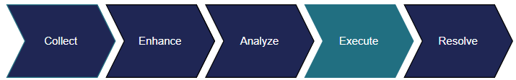
EXECUTE STAGE
The Execute stage focuses on maintenance tasks like fraud reporting and card block/reissue. These tasks will be completed through automation unless there is a workflow failure or by client request.
Account Maintenance
Recovery
Stop Payment
Fraud Reporting
Fee Maintenance
Accounting

Slide 4
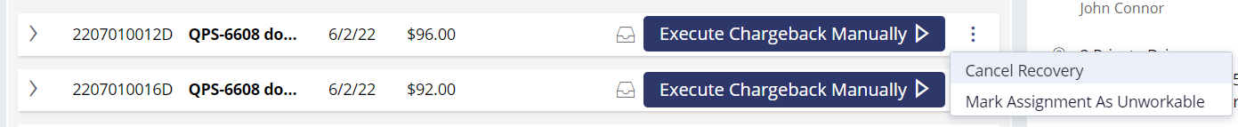
EXECUTE STAGE
WHAT CAN WE DO
If we need to pend, pay, or deny the dispute, we’ll need to choose the Cancel Recovery option from the Other Options menu. The dispute will move to the Disposition node where we can pend, pay, or deny the dispute.

Slide 5
recovery

Slide 6

RECOVERY
DETAILS
The Recovery node houses assignments that could not be complete through automation. Many of these assignments are unique to either Visa or Mastercard. Use these links for details on Association-specific assignments.
Visa
Mastercard
Accept Dispute
Execute Accept Dispute Failed
Execute Pre-arb Failed
Update Associated Tran Selection Failed
Withdraw Case Filing
Execute Case Filing
The following assignment requires manual submission of the chargeback in your firm’s Association system of choice.

Slide 7

EXECUTE CHARGEBACK
HOW TO
Manual submission of the chargeback is required in a few assignments, one of them being the Execute Chargeback assignment.
We’ll see this assignment when QFD could not submit the chargeback through automation.
Goal: Manually submit the chargeback in your firm’s Association system of choice.

Slide 8

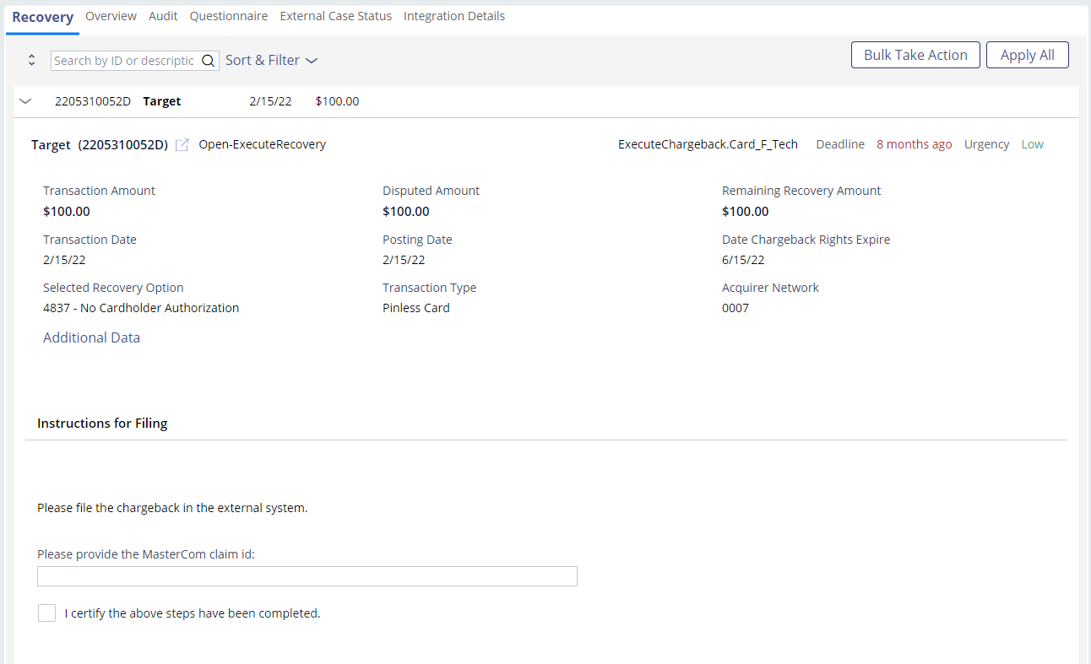





EXECUTE CHARGEBACK
EXAMPLE
Review the disputed charge for rights.
Access your firm’s Association system and submit the chargeback.
Return to QFD and provide the claim ID and answer any additional questions that present.
Check the box to certify you’ve completed the required steps.
Click the Apply button.
Click the Process Actions button.

Slide 9
accounting

Slide 10

EXECUTE ACCOUNTING
DETAILS
QFD handles accounting but should there be a failure, we’ll need to step-in and process the money movement.
Analysts will use their firm’s system of choice to complete the accounting adjustment.
Goal: Complete the accounting adjustment in your firm’s system of choice.

Slide 11
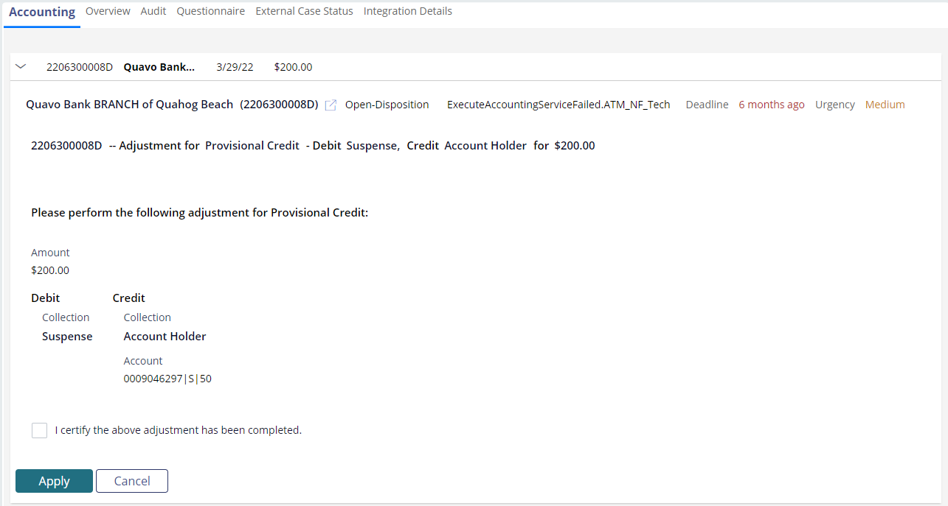
EXECUTE ACCOUNTING
EXAMPLE
Review the required accounting adjustment.
Return to QFD and check the box to certify you’ve completed the required steps.
Click the Apply button.
Access your firm’s system and complete the accounting adjustment.
Click the Process Actions button.

Slide 12
Account maintenance

Slide 13

ACCOUNT MAINTENANCE
DETAILS
The Account Maintenance node houses many automated tasks. In the event of a failure, we’ll need to manually complete the process.
These processes include blocking and reissuing the card in the event of fraud and updating the credit report status.

Slide 14

SERVICE BLOCK REISSUE CARD FAILED
DETAILS
QFD handles the block and reissue request automatically. In the event of a failure, analysts will need to complete the required tasks in their firm’s system of choice.
Goal: Complete the block and reissue tasks in your firm’s external system.

Slide 15
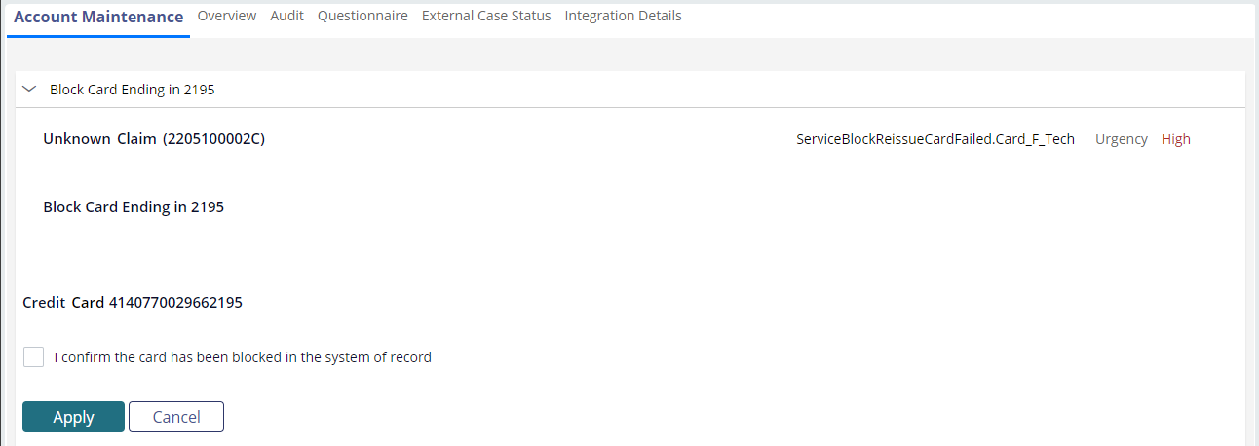
SERVICE BLOCK REISSUE CARD FAILED
EXAMPLE
Review the action that needs to be taken: Block card, reissue card, block & reissue card.
Click the Apply button.
Complete the action in your firm’s system.
Click the Process Actions button.
Return to QFD and check the box to certify you’ve completed the required steps.

Slide 16

UPDATE CREDIT REPORTING STATUS
DETAILS
Analysts will update the credit report status in an external system to reflect correctly.
Goal: Update the credit reporting status in you firm’s system of choice.

Slide 17
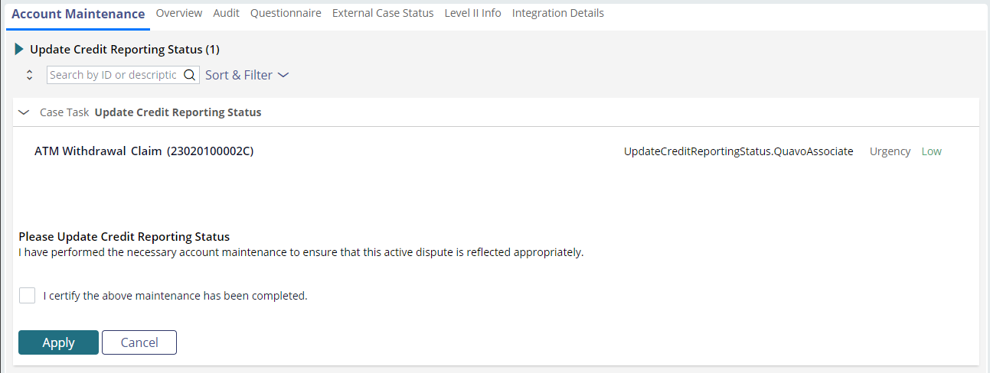
UPDATE CREDIT REPORTING STATUS
EXAMPLE
Review the dispute status (paid, denied, reopened, etc.).
Click the Apply button.
Update the credit report status in your firm’s system.
Click the Process Actions button.
Return to QFD and check the box to certify you’ve completed the required steps.

Slide 18
Fraud reporting

Slide 19

FRAUD REPORTING
DETAILS
The Fraud Reporting node houses assignments that involve fraud reporting. Expect fraud reporting to be processed automatically.
In some cases, we’ll need to manually complete fraud reporting.

Slide 20

MANUAL FRAUD REPORTING
DETAILS
The Manual Fraud Reporting assignment requires analysts to manually submit fraud reporting in an external system.
This is usually because the disputed charge was placed on an alternate network.
Goal: Submit fraud reporting in your firm’s system of choice.

Slide 21
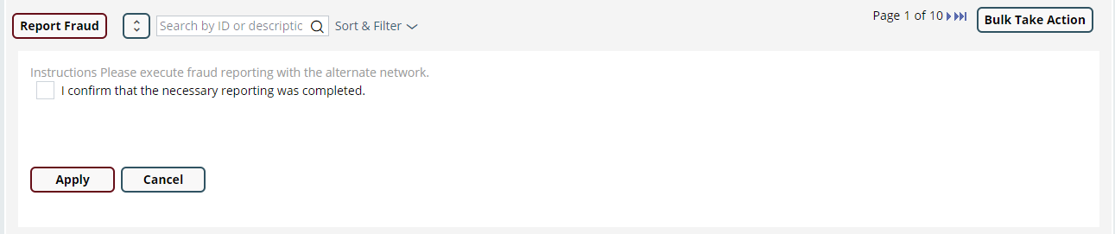
MANUAL FRAUD REPORTING
EXAMPLE
Review the instructions provided by QFD.
Click the Apply button.
Submit the fraud report for the dispute in your firm’s system of choice.
Click the Process Actions button.
Return to QFD and check the box to certify you’ve completed the required steps.

Slide 22
Stop payment

Slide 23

EXECUTE STOP PAYMENT
DETAILS
If an organization has a stop payment option, analysts will see this assignment should the accountholder request a stop payment to be processed.
Stop payment requests are processed outside of QFD.
Goal: Complete the stop payment request in your firm’s system of choice.

Slide 24
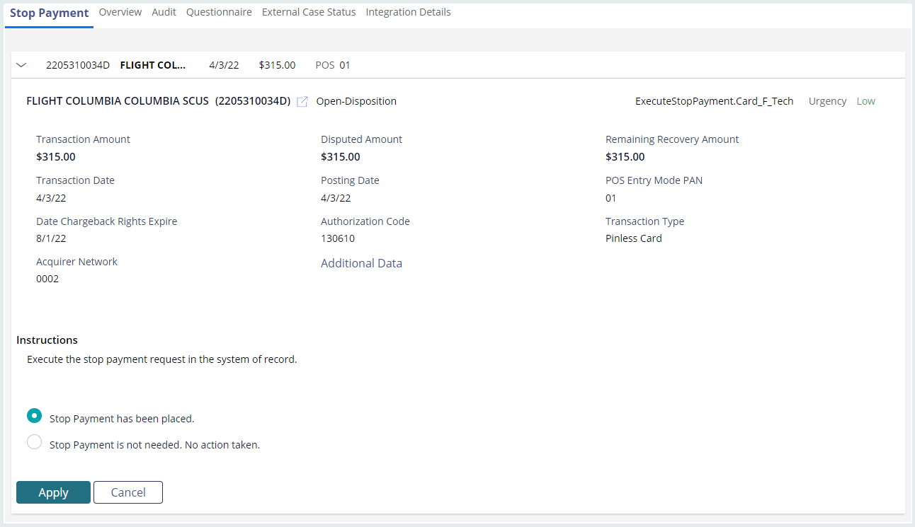
EXECUTE STOP PAYMENT
EXAMPLE
Process the stop payment request in your firm’s system.
Click the Apply button.
Select the appropriate response based on whether the stop payment was placed or not needed.
Click the Process Actions button.

Slide 25
fee maintenance

Slide 26
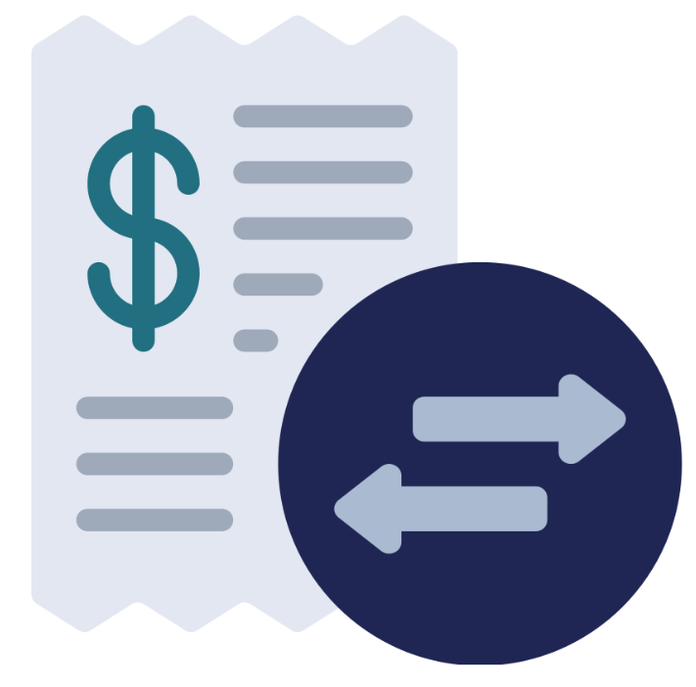
REFUND FEE
DETAILS
Fees on accounts that may be related
to the disputed charge will need to be refunded if the claim is paid.
This assignment prompts analysts to match the fee to its related disputed transaction or identify that the fee is not associated with the claim.
Goal: Match the fee to its related disputed charge or identify that the fee isn’t associated with the claim.

Slide 27
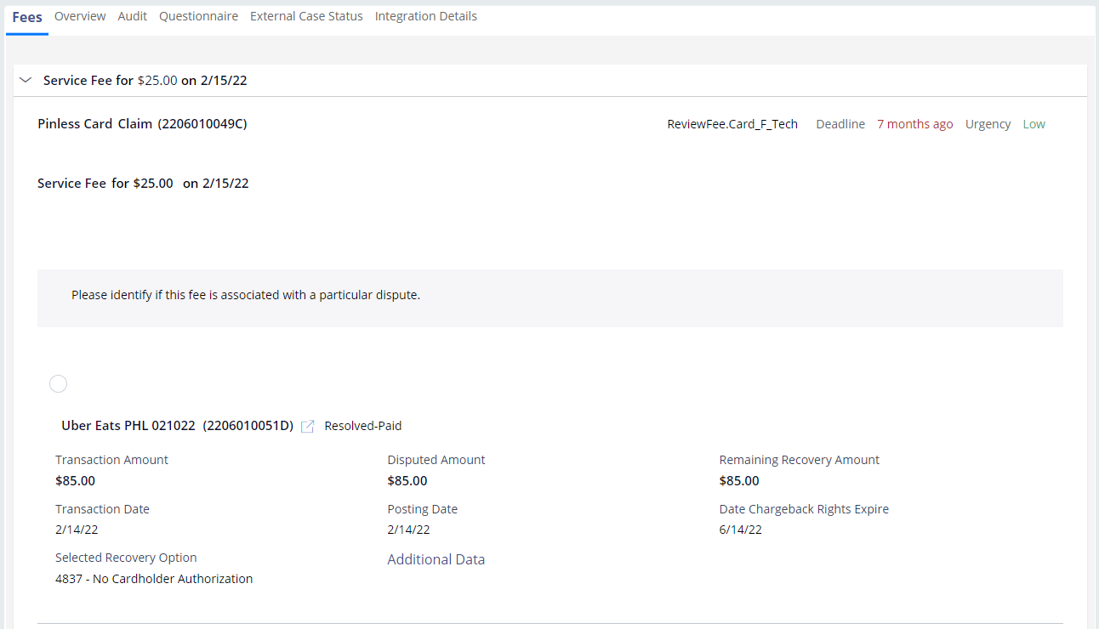
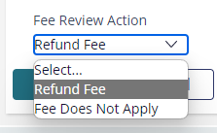
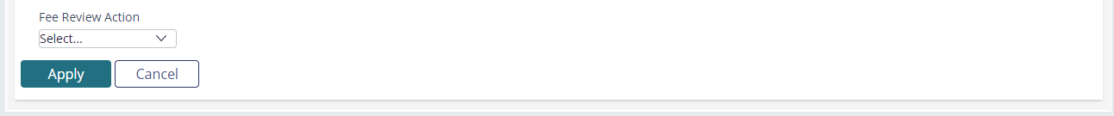
REFUND FEE
EXAMPLE I: MATCH
Select the related transaction.
Click the Apply button.
Select the Refund Fee option from the Fee Review Action drop-down.
Click the Process Actions button.

Slide 28
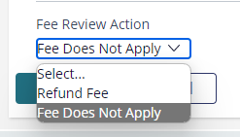
REFUND FEE
EXAMPLE II: NOT ASSOCIATED
Click the Apply button.
Select the Fees Does Not Apply option from the Fee Review Action drop-down.
Click the Process Actions button.

