Slide 1
Enhance Assignments
Back-office Part I

Slide 2
Assignments
Authorization Review | Confluence
Select Transaction | Confluence
Provide Reference Key | Confluence
Process Enrichment Manually | Confluence
Provide Enrichment Prerequisite Data | Confluence
Provide Required Enrichment Data | Confluence
Review Documents | Confluence

Slide 3
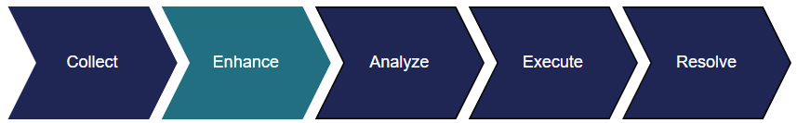
ENHANCE STAGE
The Enhance stage is the first point where actions are taken in the back office following claim intake.
Analysts work Enhance assignments to prepare disputed transactions for recovery.
Authorization
Enrichment
Documentation

Slide 4
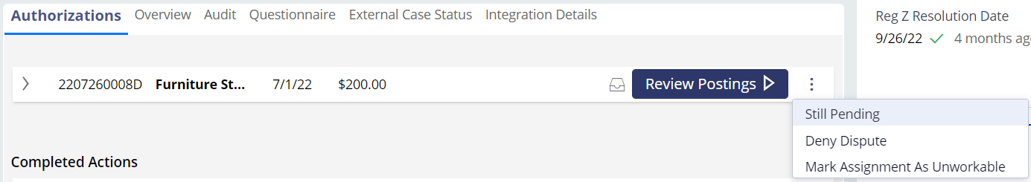
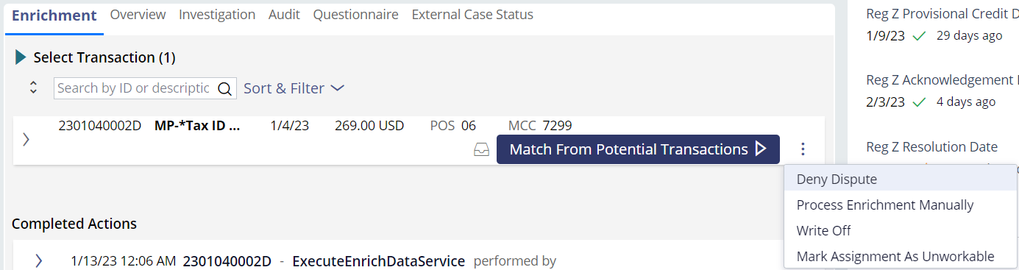
ENHANCE STAGE
WHAT CAN WE DO
We may determine to deny, pay, or pend the claim when the dispute is in the Enhance stage. You can access these functions from the Other Actions menu.
Authorization
Enrichment

Slide 5
Authorizations

Slide 6

AUTHORIZATION
DETAILS
Authorizations on a debit or credit account are also known as pending transactions. These transactions are approved by the purchaser’s bank, but they have not yet completed.
QFD allows pending transactions to be disputed. The claim will not move forward until the transaction has posted to the account. QFD will check to see if the transaction has posted every 6 hours for five days.
We will manually check to see if the transaction has posted as a part of the Authorization Review assignment.

Slide 7



AUTHORIZATION
HOW TO
Goal: Determine if the pending transaction posted to the account.
The transaction has posted
The transaction has not posted
Match the pending transaction to the posted transaction.
Match the merchant name, transaction amount and date.
If it’s been 5 days, deny the dispute.
If it’s within 5 days, pend the dispute.

Slide 8
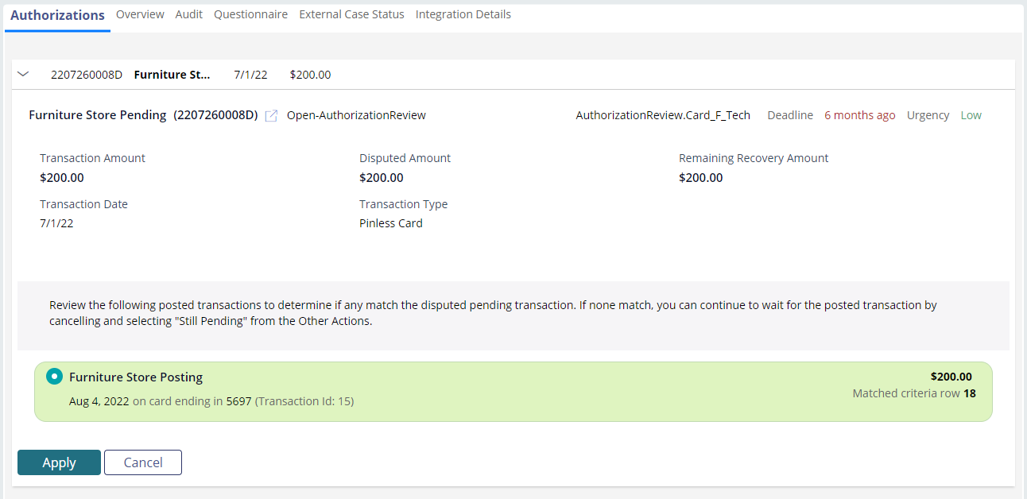


AUTHORIZATION
EXAMPLE I: MATCH
Click the Apply button.
Click the Process Actions button.

Slide 9
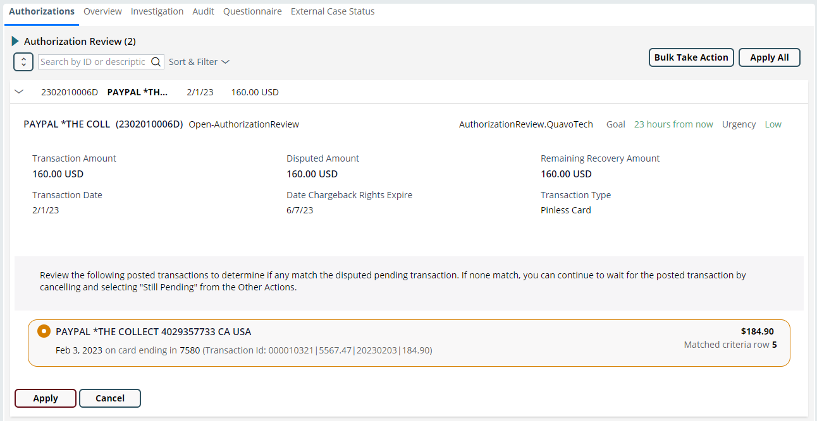

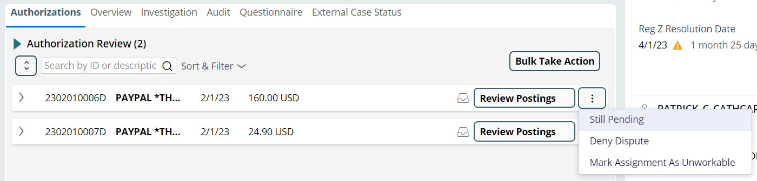


AUTHORIZATION
EXAMPLE II: NO MATCH
Click the Cancel button.
Click the Other Actions button.
A. Select the Still Pending option if it hasn’t been 5 days since the authorization date.
B. Select the Deny Dispute option if it has been 5 days since the authorization date.
Click the Apply button.
Click the Process Actions button.

Slide 10
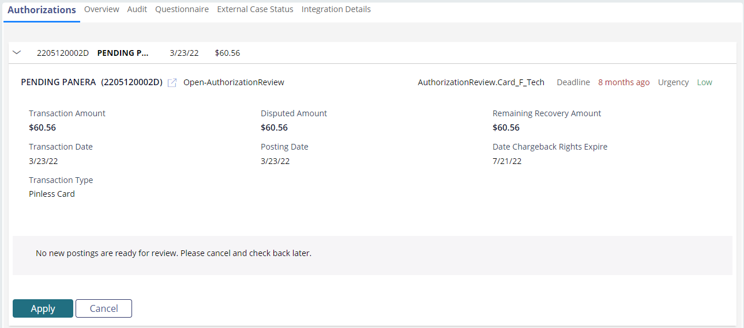
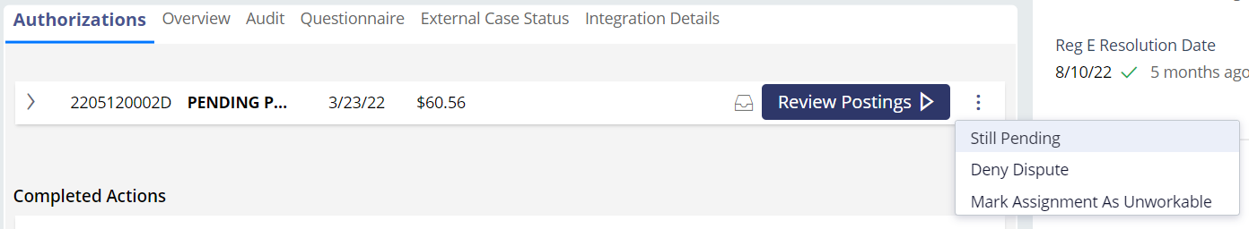
AUTHORIZATION
EXAMPLE III: NO RESULTS
Click the Cancel button.
B. Select the Deny Dispute option if it has been 5 days since the authorization date.
Click the Other Actions button.
Click the Apply button.
A. Select the Still Pending option if it hasn’t been 5 days since the authorization date.
Click the Process Actions button.

Slide 11
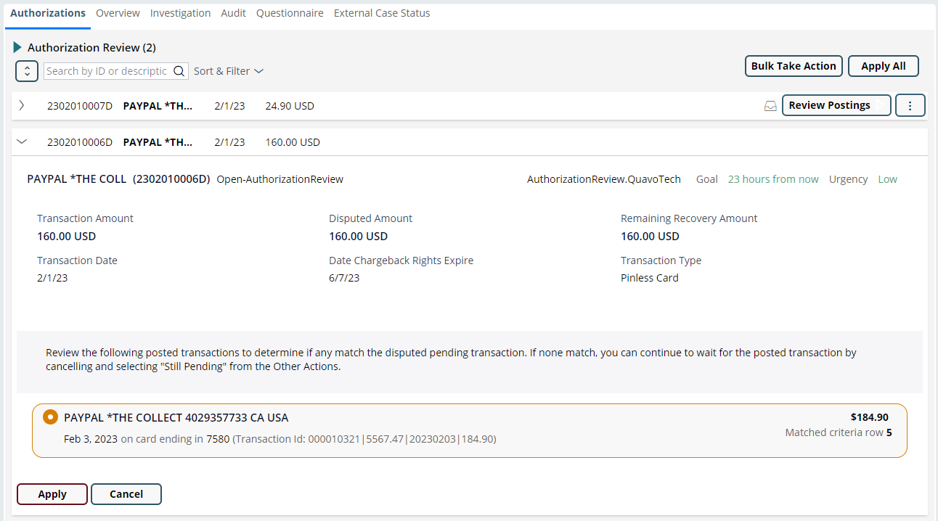
AUTHORIZATION
EXAMPLE IV: SPLIT AUTHORIZATION
Verify the approval code using your firm’s preferred system.
Click the Apply button.
Select the authorization that has the higher dollar amount in QFD or the transaction with the matching approval code.
Click the Process Actions button.
Notes:
Merchant split the authorization into 2 pending charges. We can recover on the $160 and not the $24.90 so use the $160.

Slide 12
Enrichment

Slide 13

ENRICHMENT
DETAILS
QFD gets transaction data from the client’s system of record during the claim intake process.
QFD will make a call to the network to get richer transaction data that will assist in the investigation.
The process of getting more transaction info is called enrichment.
Manual enrichment assignments include transaction matching and data entry.

Slide 14


ENRICHMENT
HOW TO
Goal: Get more transaction data.
There are two types of enrichment assignments: Transaction match and provide data.
Transaction Match:
Match the disputed transaction to the potential matches from the network. Match the merchant name, transaction amount and date.
Select Transaction
Provide Reference Key
Provide Data:
You’ll need to fill out the transaction information to make a manual call to the network. Assignments:
Process Enrichment Manually
Provide Enrichment Prerequisite Data
Provide Required Enrichment Data

Slide 15
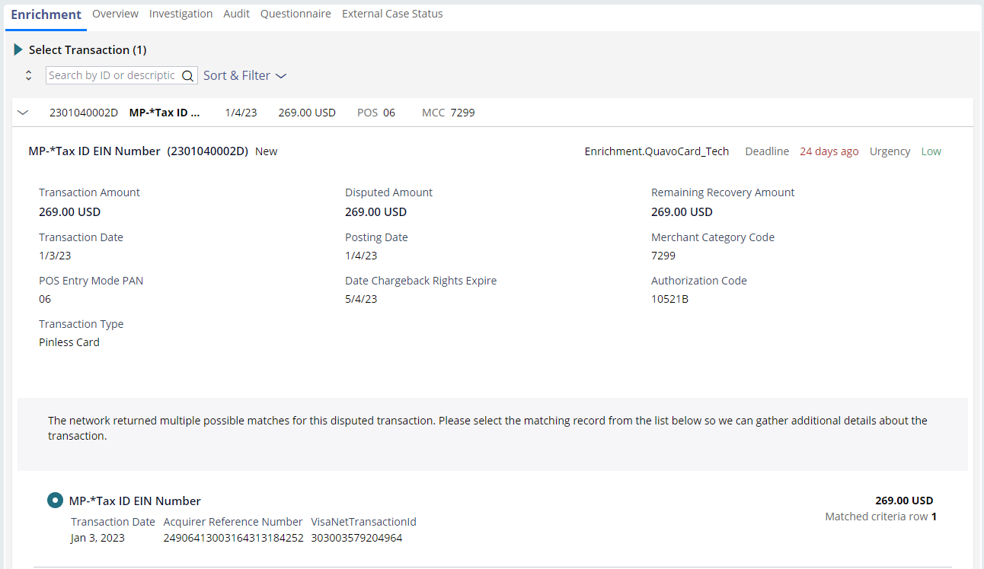
SELECT TRANSACTION
EXAMPLE I: MATCH
Click the Apply button.
Click the Process Actions button.

Slide 16

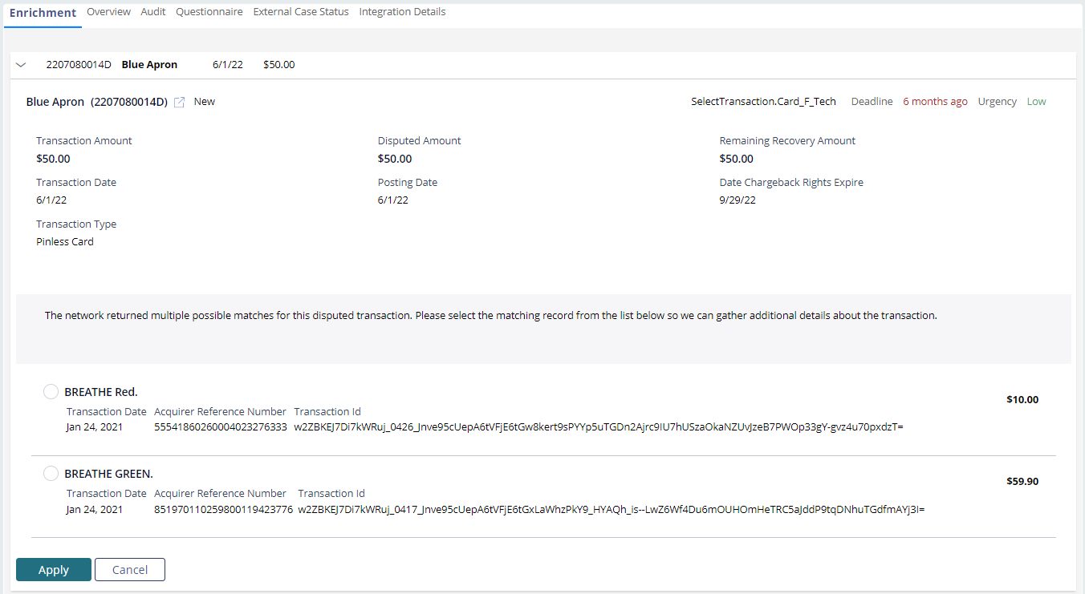

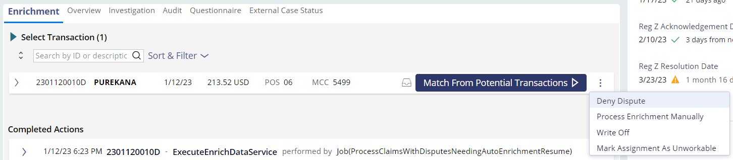
SELECT TRANSACTION
EXAMPLE I: NO MATCH
Click the Cancel button.
Click the Other Actions button.
Select the Process Enrichment Manually option.
Follow the instructions provided by QFD and enter the required data.
Click the Apply button.
Click the Process Actions button.
Jump to Process Enrichment Manually

Slide 17
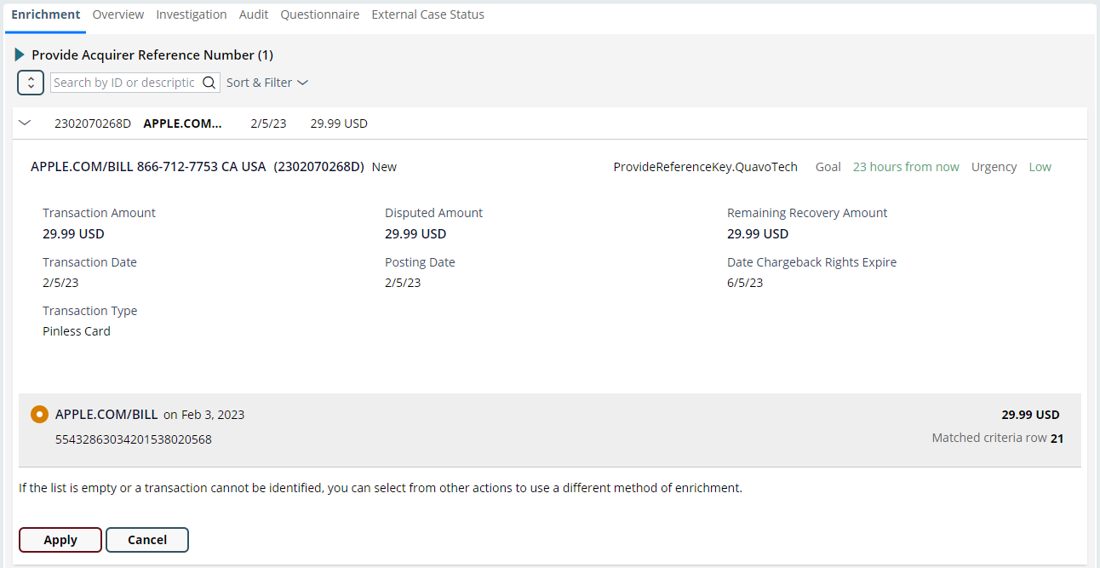
PROVIDE REFERENCE KEY
EXAMPLE I: MATCH
Click the Apply button.
Click the Process Actions button.

Slide 18
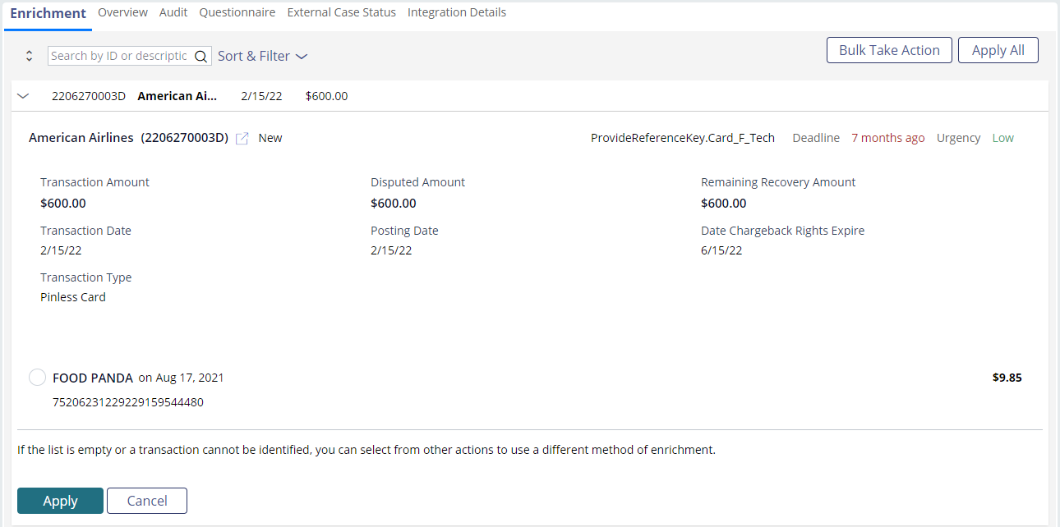
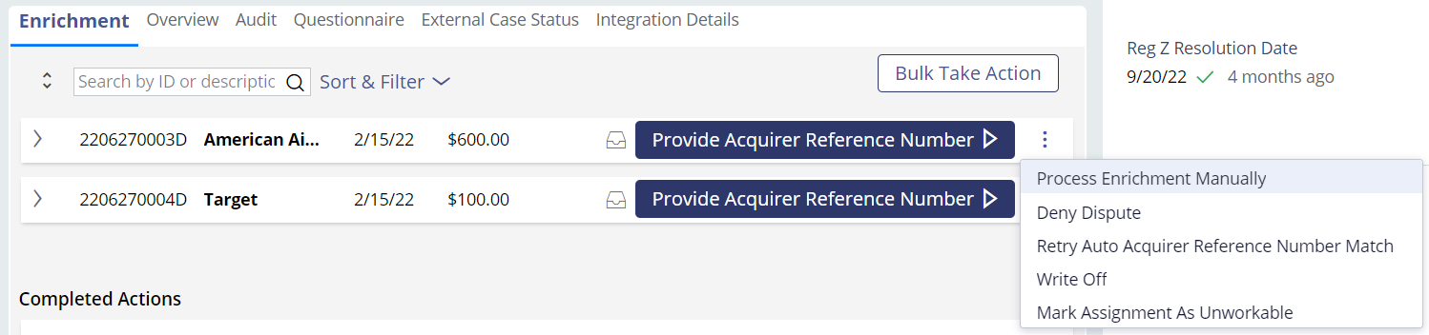
PROVIDE REFERENCE KEY
EXAMPLE II: NO MATCH
Click the Cancel button.
Click the Other Actions button.
Select the Process Enrichment Manually option.
Follow the instructions provided by QFD and enter the required data.
Click the Apply button.
Click the Process Actions button.
Jump to Process Enrichment Manually

Slide 19
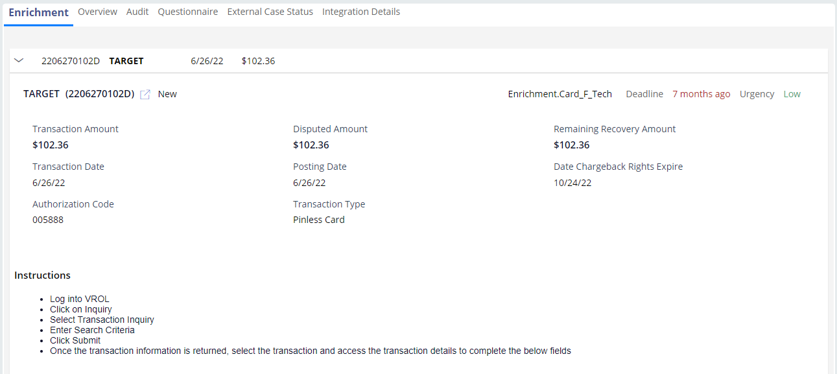
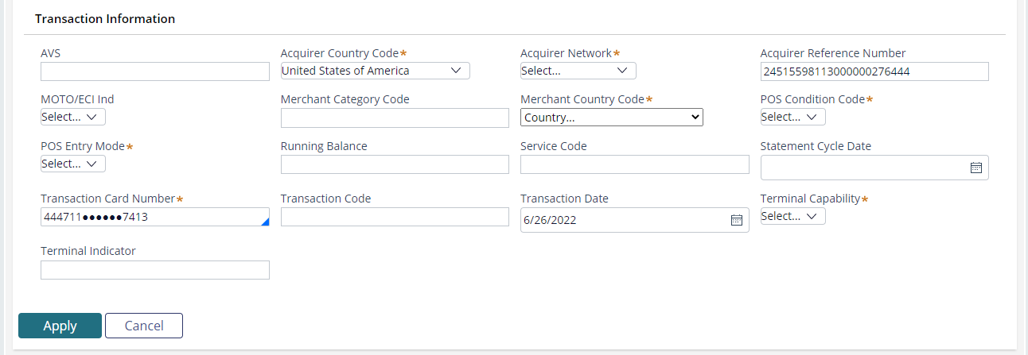
PROCESS ENRICHMENT MANUALLY
EXAMPLE
Follow the instructions provided by QFD and enter the required data.
Click the Apply button.
Click the Process Actions button.

Slide 20
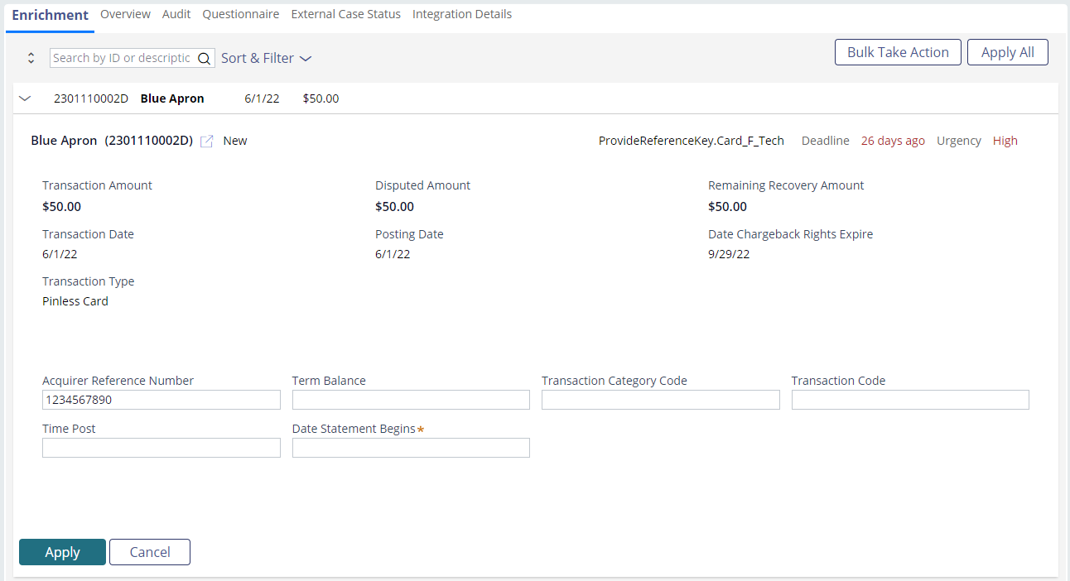
PROVIDE ENRICHMENT PREREQUISITE DATA
EXAMPLE
Enter the required data.
Click the Process Actions button.
Click the Apply button.

Slide 21
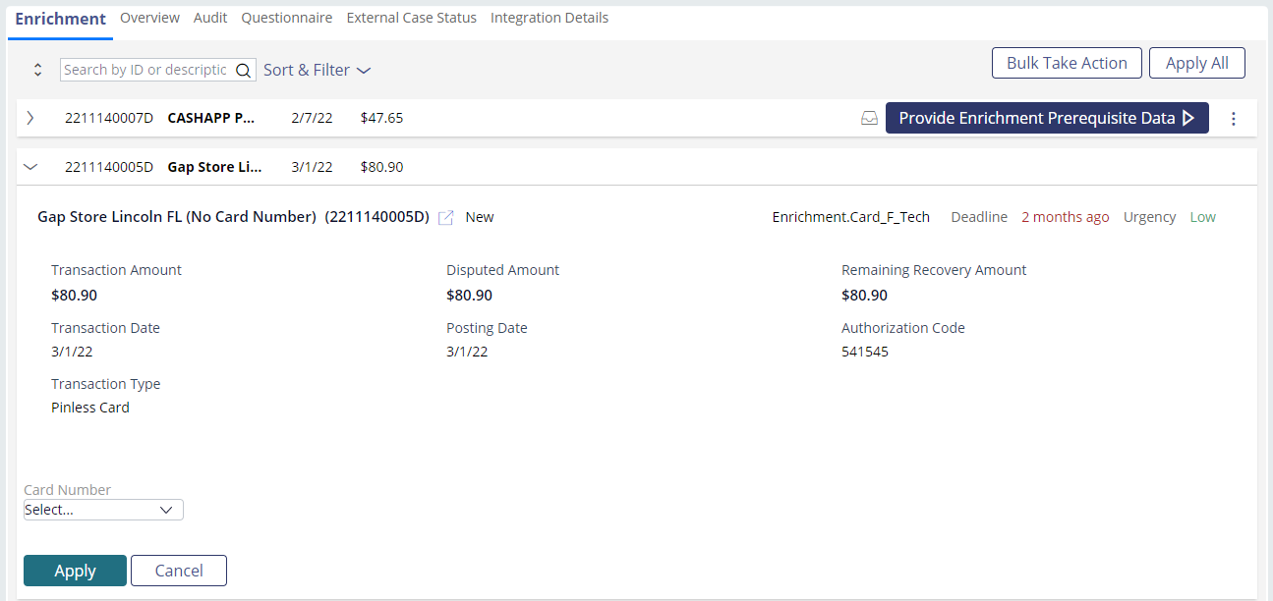
PROVIDE REQUIRED ENRICHMENT DATA
EXAMPLE
Select the correct card number from the drop-down.
Click the Apply button.
Click the Process Actions button.

Slide 22
Documentation

Slide 23

DOCUMENTATION
DETAILS
Some claim types require documentation in order to pursue recovery. These claims will reflect the Review Documents assignments once the accountholder submits the requested documentation.
Documents that are required based on
the claim type:
Proof of payment by other means
Proof credit is due
Written Statement of Unauthorized Debit
Statement of Dispute

Slide 24

DOCUMENTATION
HOW TO
Goal: Review the required documentation that the accountholder submitted or that was uploaded by a front-office specialist.
If the document satisfies the requirement, we can complete the assignment.
If the document doesn’t satisfy the requirement, we may need to request the document a second time.

Slide 25
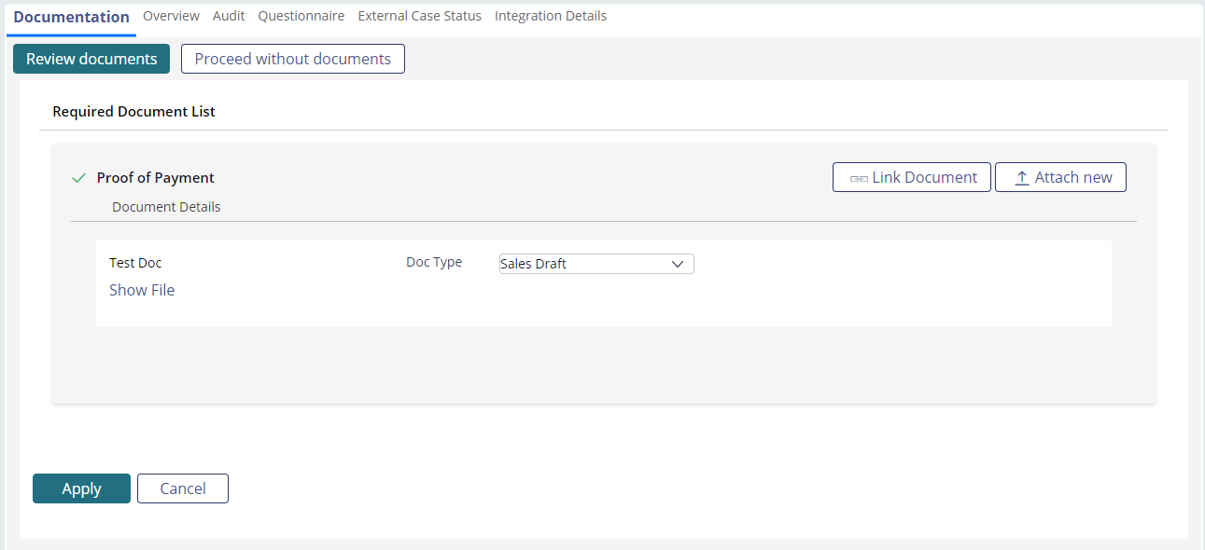
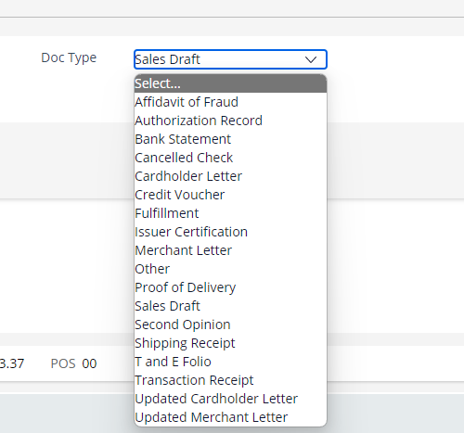
REVIEW DOCUMENTS
EXAMPLE I: DOCUMENTS MEET REQUIREMENTS
Click the Show File hyperlink to view the document.
Click the Apply button.
Select the correct document type from the Doc Type drop-down.
Click the Process Actions button.

Slide 26
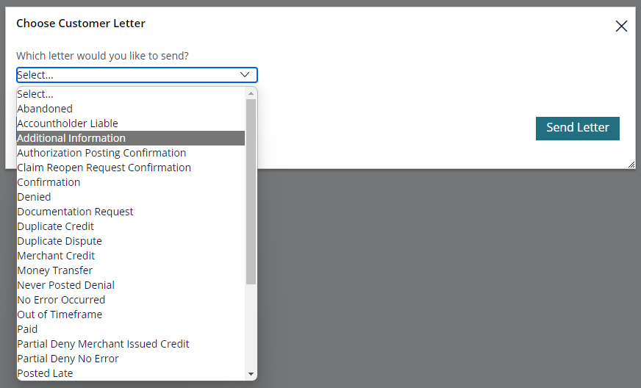
REVIEW DOCUMENTS
EXAMPLE II: DOCUMENTS DO NOT MEET REQUIREMENTS
Click the Show File hyperlink to view the document.
Click the Apply button.
Send an Additional Information letter from the Communication HUB.
Click the Proceed without documents button.
Click the Process Actions button.

