Slide 1
Analyze Assignments
Back-office Part II

Slide 2
Assignments
Check for Merchant Credit | Confluence
Grant Provisional Credit | Confluence
Review Fees | Confluence
Interest Calculation | Confluence
Disposition Case | Confluence
Review Chargeback | Confluence
Review Dispute Response | Confluence
Process Liability | Confluence
Inbound Communication | Confluence

Slide 3
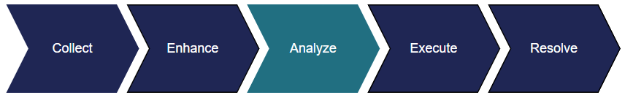
ANALYZE STAGE
The Analyze stage houses most of the assignments analysts work to resolve the claim. The majority of Analyze assignments involve recovery.
Collaboration
Disposition
Provisional Credit
Responses

Slide 4
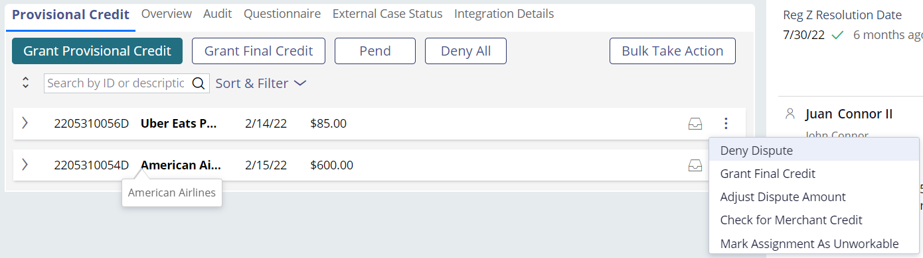
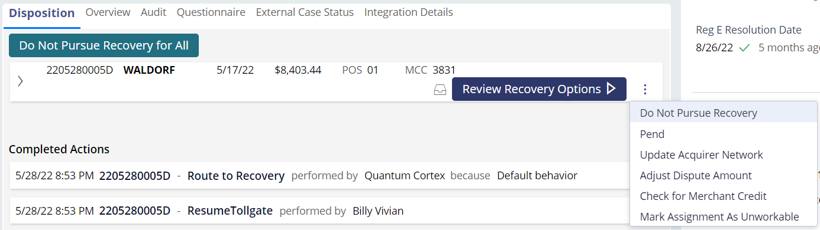
ANALYZE STAGE
WHAT CAN WE DO
We may determine to deny, pay, or pend the claim when the dispute is in the Analyze stage. You can access these functions from the Other Actions menu.
Provisional Credit
Disposition

Slide 5
collaboration

Slide 6

COLLABORATION
DETAILS
Dispute resolution can be a long, expensive process. Services like Verifi and Ethoca give the merchant a chance to resolve the dispute before we proceed with recovery.
QFD will work with Verifi and Ethoca to resolve the claim early. If the merchant is not eligible or doesn’t respond, the claim will move on to the next stage.
QFD will check the system to locate a refund from the merchant several times throughout the dispute process, regardless if Verifi or Ethoca are integrated.

Slide 7



COLLABORATION
HOW TO
Goal: Determine if the disputed transaction was refunded.
The transaction was refunded
The transaction has not been refunded
Match the disputed transaction to the refund.
Match the merchant name, transaction amount and date.
Select No Credit Found.
Process the action.

Slide 8
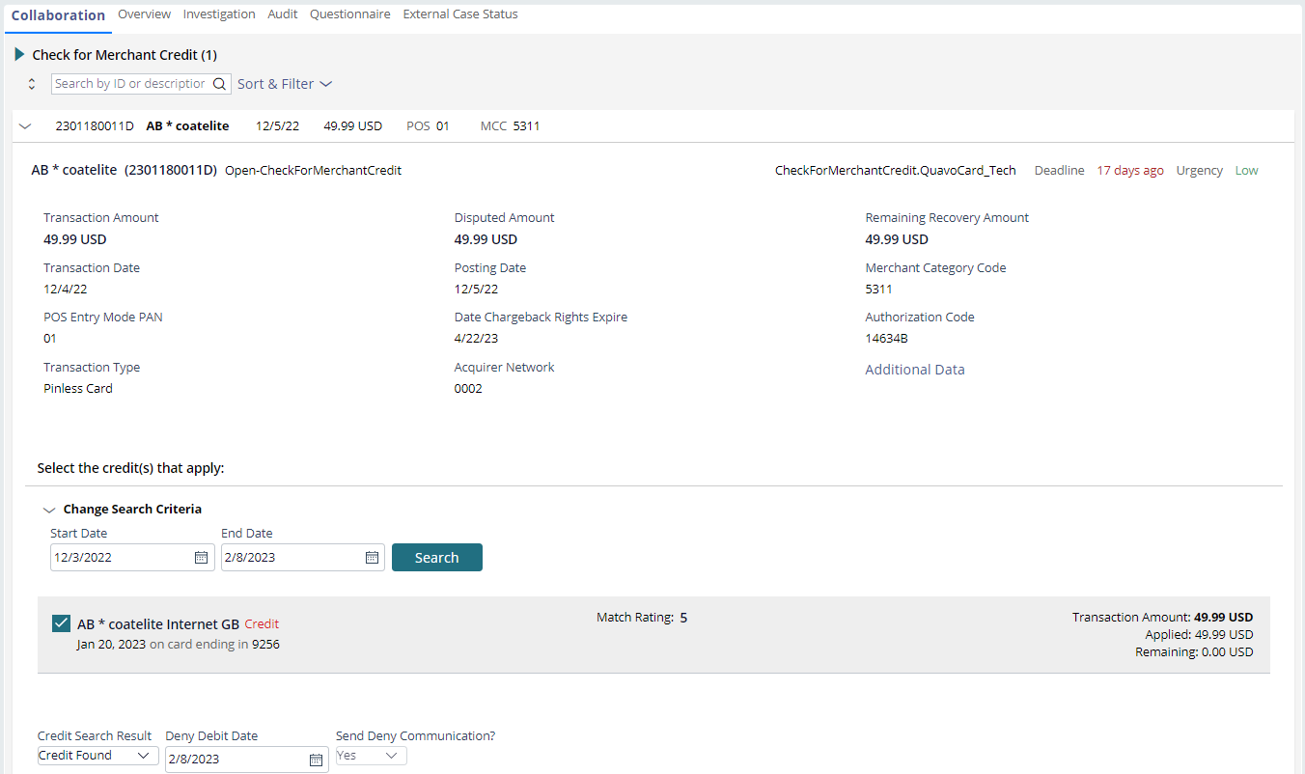


COLLABORATION
EXAMPLE I: MATCH
Select the matching credit.
Review the Deny letter and confirm the Deny Debit Date meets compliance requirements.

Slide 9
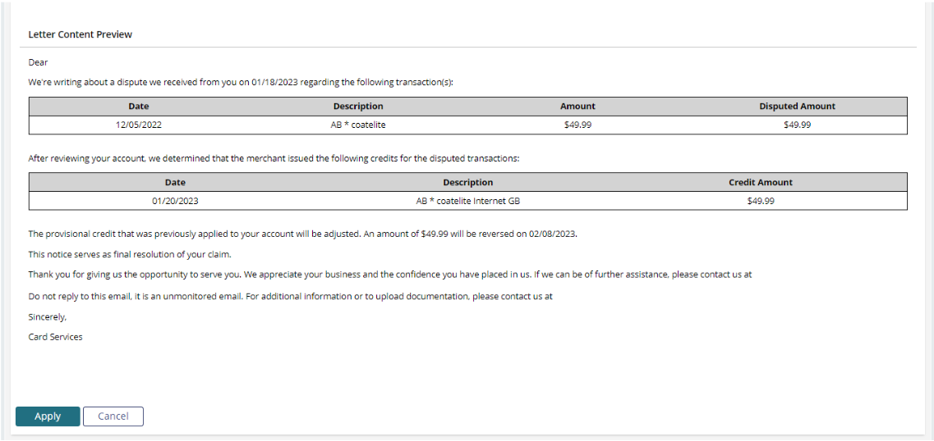


COLLABORATION
EXAMPLE I: MATCH
Click the Apply button.
Click the Process Actions button.

Slide 10
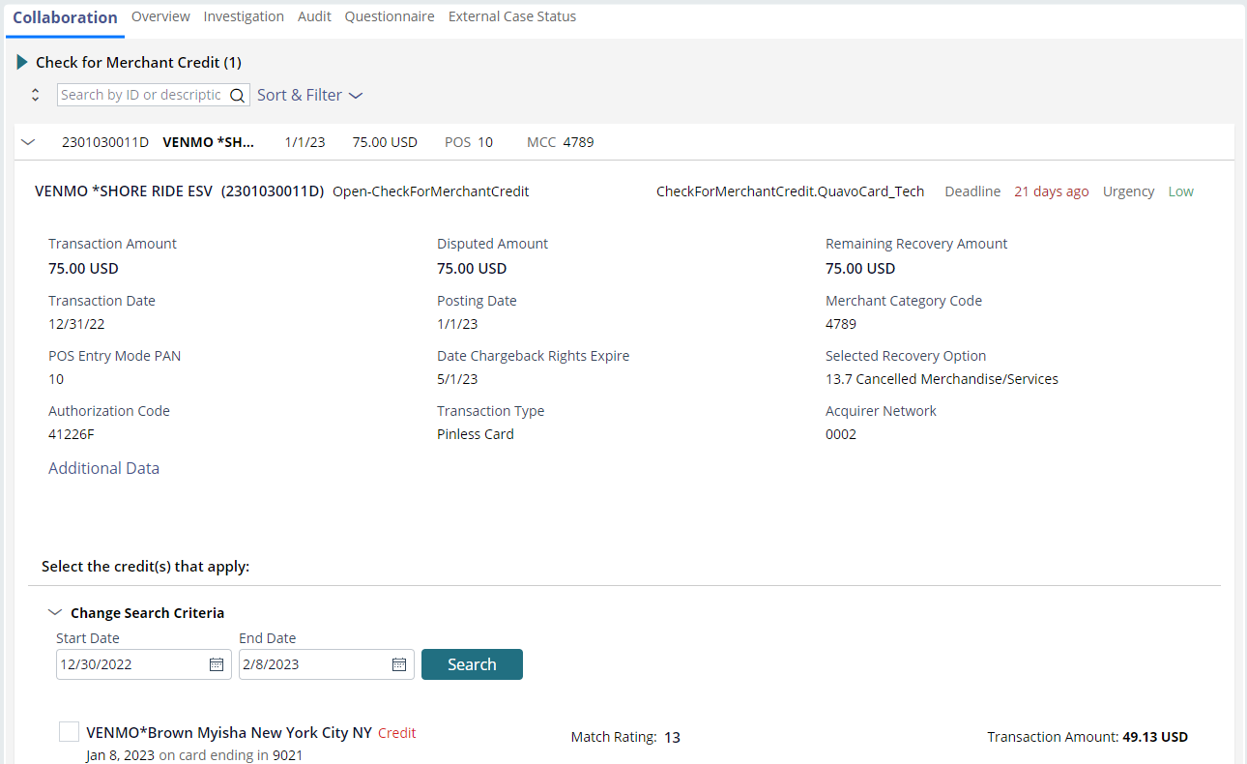
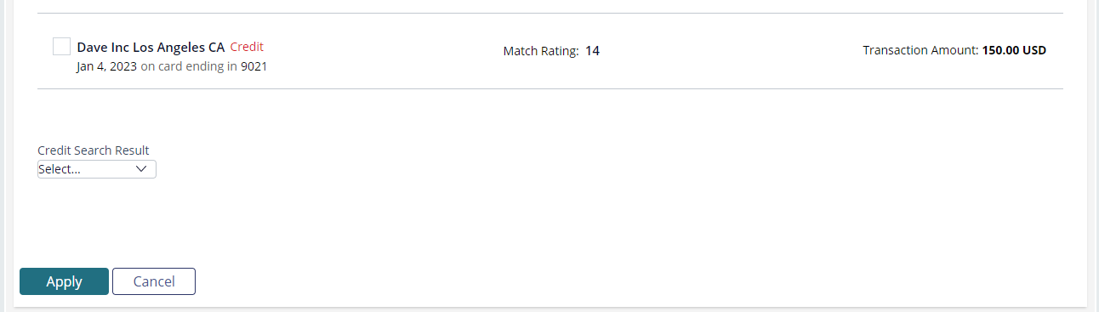
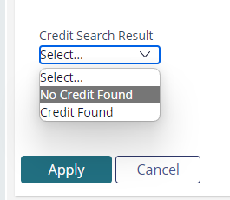
COLLABORATION
EXAMPLE II: NO MATCH
Select the No Credit Found option from the Credit Search Result drop-down.
Click the Apply button.
Click the Process Actions button.

Slide 11
Provisional credit

Slide 12

PROVISIONAL CREDIT
DETAILS
A provisional credit is a temporary credit issued to a member's account.
The purpose of a provisional credit is to prevent additional monetary loss due to an unauthorized charge or disputed transaction.
Provisional credits are granted after we complete an investigation.
Notes:
Tell: We grant a provisional credit to make the cardholder whole while we continue our investigation and submit the chargeback. Know that the provisional is temporary and can be revoked should we determine the cardholder is truly liable for the charge.
Keep in mind that we’ll only grant provisional credit if a refund has not been received and there are chargeback rights.

Slide 13




PROVISIONAL CREDIT
HOW TO
Goal: Grant provisional credit or pay, deny, or pend the dispute.
Grant provisional credit
Take another action
After you determine provisional credit should be issued, complete the assignment and review the Provisional Credit letter.
As determined by your investigation, you can pay or deny the dispute, or pend for a specified reason.
Notes:
Tell: When we’re ready to grant provisional credit, we will select the Grant Provisional Credit button. This will preview the provisional credit letter that will be sent to the cardholder. Review the letter to ensure it’s addressed to the correct cardholder and that the transaction matches the disputed charge. Click on the Apply button then click on the Process Actions button to complete the task. Note that you granted a provisional credit for the dispute following the note example shown. You can copy/paste the note template in the Specialist Confluence page.

Slide 14
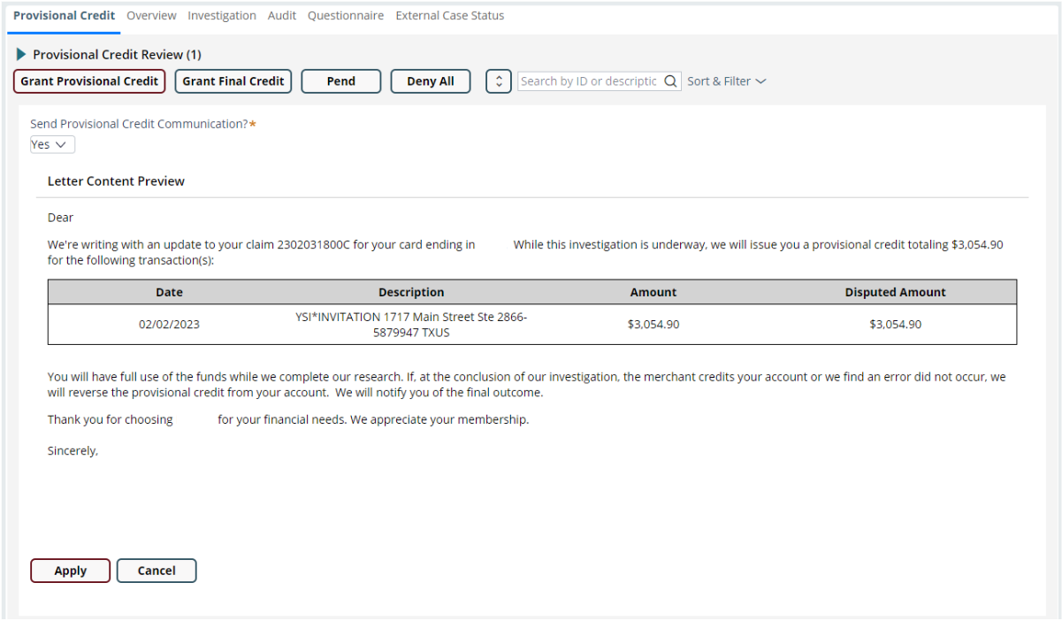
PROVISIONAL CREDIT
EXAMPLE I: GRANT PROVISIONAL CREDIT
Click the Grant Provisional Credit button.
Click the Apply button.
Review the Provisional Credit letter.
Click the Process Actions button.

Slide 15
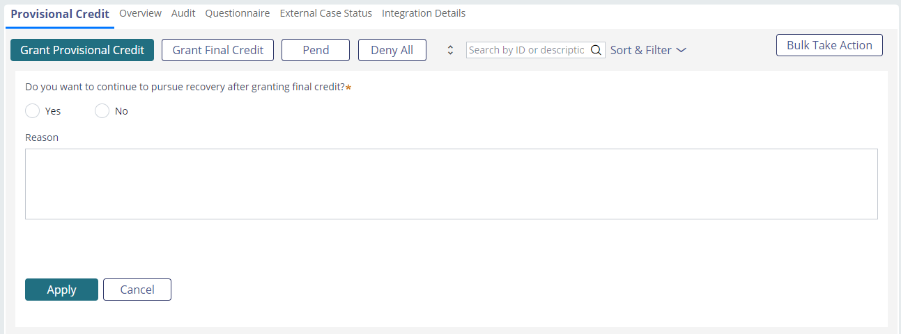
PROVISIONAL CREDIT
EXAMPLE II: TAKE ANOTHER ACTION - PAY
Pay
Click the Grant Final Credit button to pay all disputes with the Provisional Credit assignment.
Select the Grant Final Credit option from the Other Actions menu to pend the selected dispute only.
Answer Yes or No to Do you want to continue to pursue recovery after granting final credit?
Provide the pay reason.
Apply and process.

Slide 16
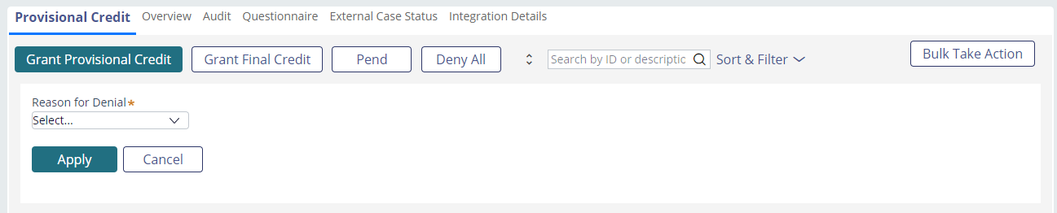
PROVISIONAL CREDIT
EXAMPLE II: TAKE ANOTHER ACTION - DENY
Deny
Click the Deny All button to deny all the disputes with the Provisional Credit assignment.
Select the Deny Dispute option from the Other Actions menu to deny only the selected dispute.
Select the deny reason from the Reason for Denial drop-down.
Review the deny letter for accuracy.
Apply and process.

Slide 17
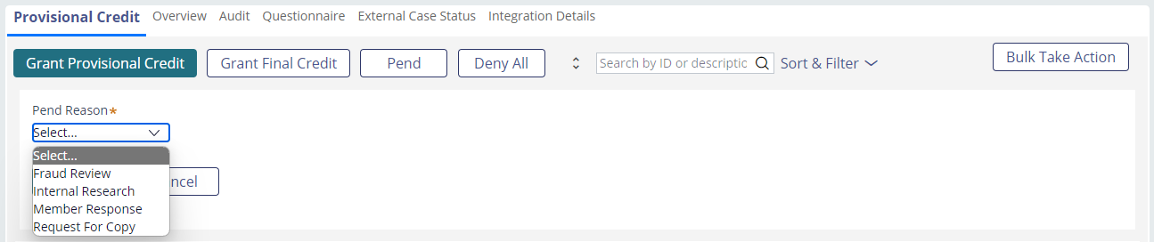
PROVISIONAL CREDIT
EXAMPLE II: TAKE ANOTHER ACTION - PEND
Pend
Click the Pend button to pend all disputes with the Provisional Credit assignment.
Select the Pend option from the Other Actions menu to pend the selected dispute only.
Select the Pend Reason from the drop-down.
Determine the pend timeframe from the Calendar days drop-down.
Answer additional questions if you’re pending for Member Response.
Apply and process.

Slide 18
fees

Slide 19

REVIEW FEES
DETAILS
Fees on accounts that may be related
to the disputed charge will need to be refunded if the claim is paid.
This assignment prompts analysts to match the fee to its related disputed transaction or identify that the fee is not associated with the claim.
Goal: Match the fee to its related disputed charge or identify that the fee isn’t associated with the claim.

Slide 20
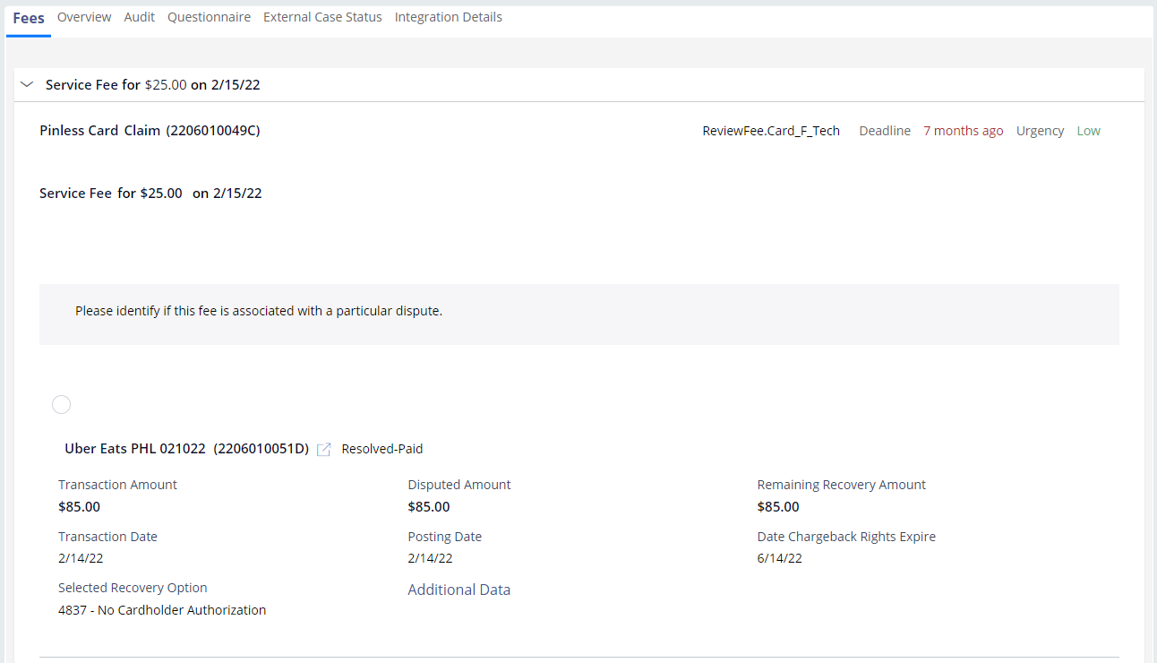
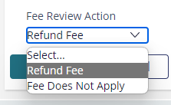
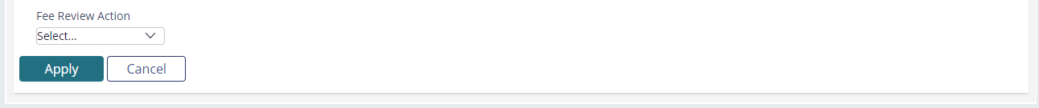
REVIEW FEES
EXAMPLE I: MATCH
Select the related transaction.
Click the Apply button.
Select the Refund Fee option from the Fee Review Action drop-down.
Click the Process Actions button.

Slide 21
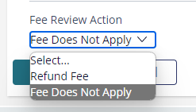
REVIEW FEES
EXAMPLE II: NOT ASSOCIATED
Click the Apply button.
Select the Fees Does Not Apply option from the Fee Review Action drop-down.
Click the Process Actions button.

Slide 22
interest

Slide 23

INTEREST CALCULATION
DETAILS
Interest fees need to be considered when working a claim on an interest-bearing accounts.
This assignment prompts analysts to calculate the relevant interest fee which will be refunded if the claim is paid.
Goal: Calculate the interest fee for the disputed transaction.

Slide 24
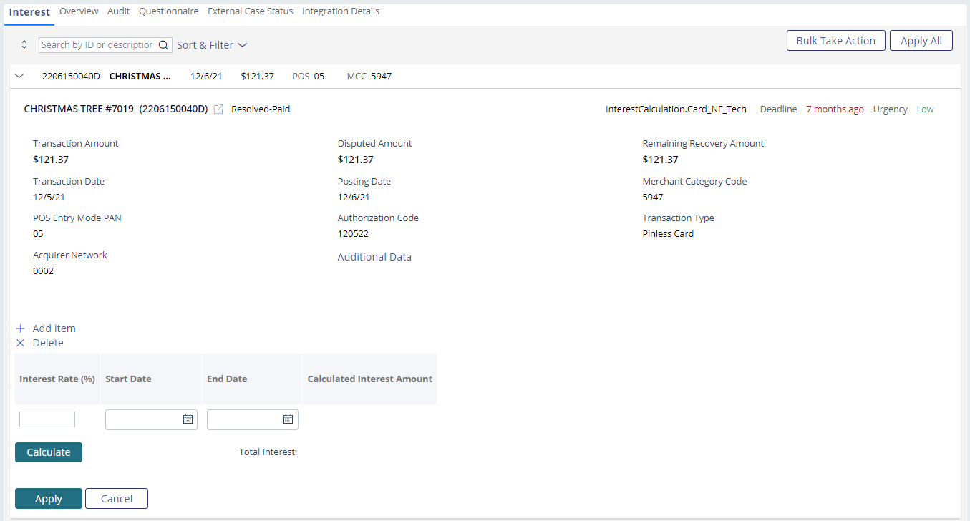

INTEREST CALCULATION
EXAMPLE
Enter the account’s interest rate in the Interest Rate (%) field.
Click the Calculate button.
Click the Apply button.
Enter the interest period start and end date.
Click the Process Actions button.

Slide 25
disposition

Slide 26

DISPOSITION
DETAILS
The Disposition node houses assignments that involve the chargeback, pursuing recovery by other means, and processing liability.
In this section, we’ll cover a few key
Disposition assignments:
Disposition Case
Review Chargeback
Review Dispute Response
Process Liability

Slide 27

DISPOSITION CASE
HOW TO
The Disposition Case assignment involves submitting the chargeback to the Acquirer.
If you determine that the dispute should be paid, denied or pended, you can access these options from the Other Actions menu.
Goal: Complete and review the chargeback form to submit the chargeback.
Review the disputed transaction and determine if recovery should be pursued.

Slide 28
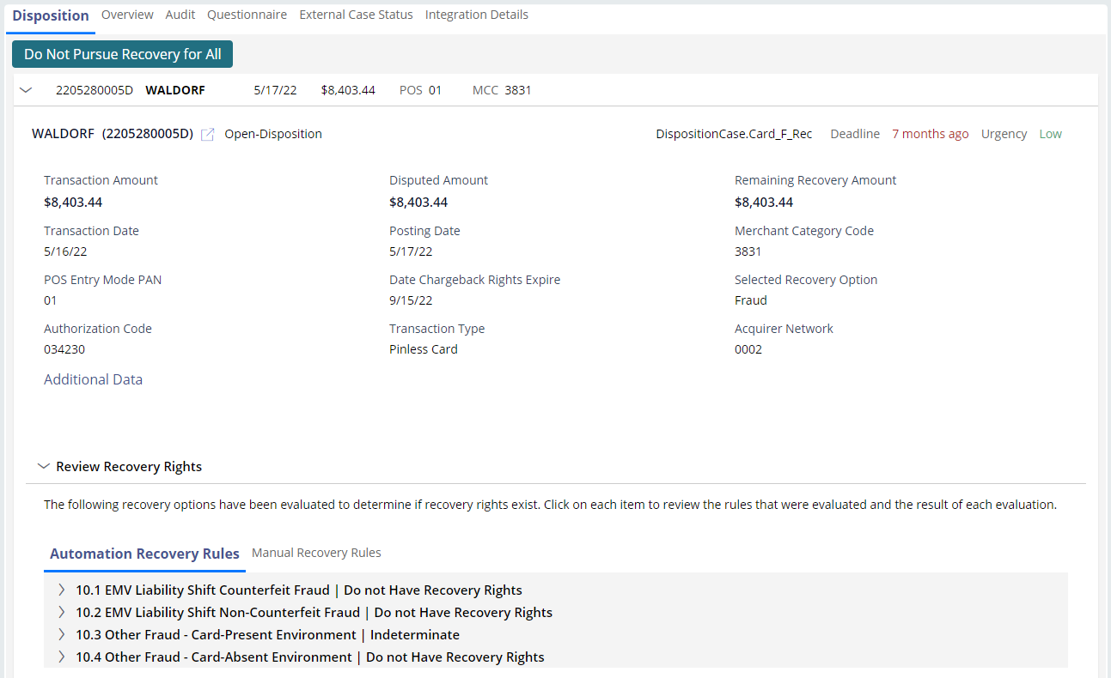
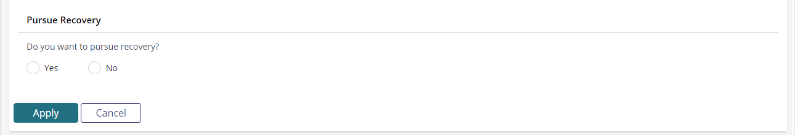
DISPOSITION CASE
EXAMPLE I: PURSUE RECOVERY
Select Yes under Do you want to pursue recovery?
Ensure the selections under the Review Recovery Options Dependencies are correct.

Slide 29
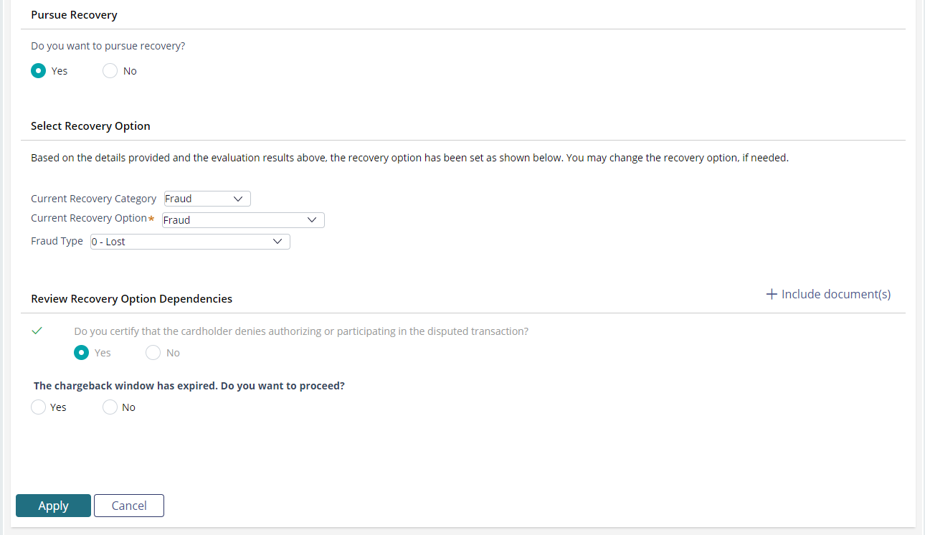
DISPOSITION CASE
EXAMPLE I: PURSUE RECOVERY
Click the Apply button.
Click the Process Actions button.

Slide 30
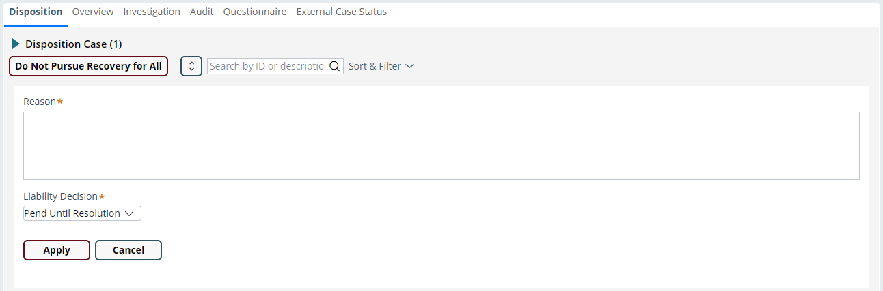
DISPOSITION CASE
DO NOT PURSUE RECOVERY
Pend Until Resolution
Click the Do Not Pursue Recovery for All button to move all disputes with the Disposition case assignment out of recovery.
Select the Do Not Pursue Recovery option from the Other Actions menu to move only the selected dispute out of recovery.
Select the Pend Until Resolution option under the Liability Decision drop-down.
The Pend Until Resolution function will pend the disputed charge(s) until we receive the merchant’s response to the chargeback.

Slide 31
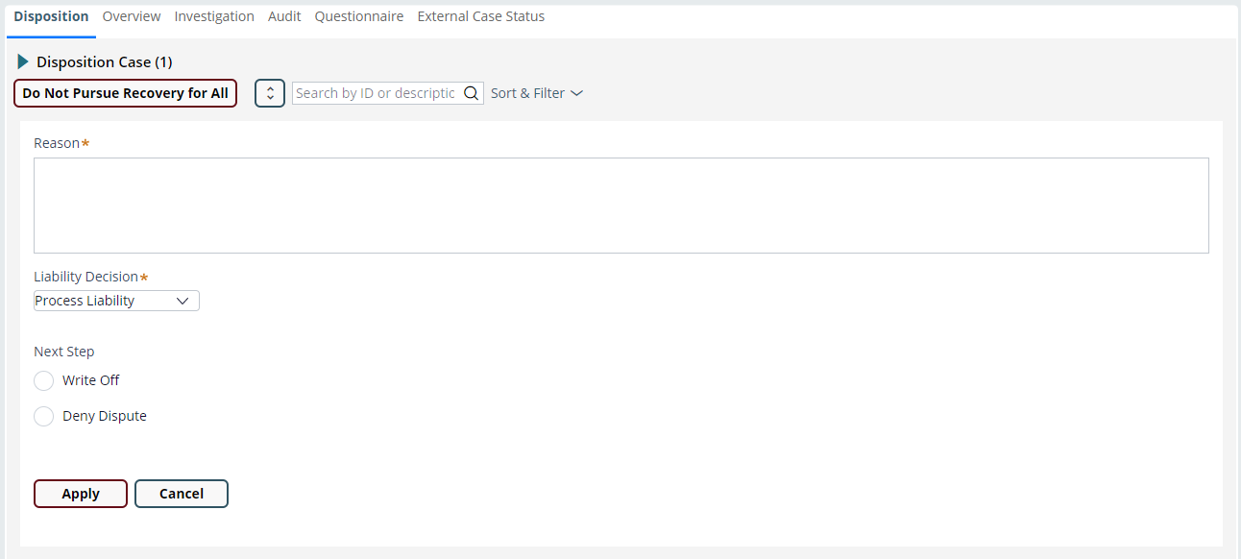
DISPOSITION CASE
DO NOT PURSUE RECOVERY
Process Liability
Click the Do Not Pursue Recovery for All button to move all disputes with the Disposition case assignment out of recovery.
Select the Do Not Pursue Recovery option from the Other Actions menu to move only the selected dispute out of recovery.
Select the Process Liability option under the Liability Decision drop-down.
The Pend Until Resolution function will pend the disputed charge(s) until we receive the merchant’s response to the chargeback.

Slide 32

DISPOSITION CASE
PEND
Pend
Select the Pend option from the Other Actions menu.
Select the Pend Reason from the drop-down.
Determine the pend timeframe from the Calendar days drop-down.
Answer additional questions if you’re pending for Member Response.

Slide 33

REVIEW CHARGEBACK
HOW TO
The Review Chargeback assignment requires analysts to review the chargeback form and make the required corrections.
The corrections are required prior to the chargeback submission.
Typically, these corrections involve the accountholder’s responses to the intake questionnaire.
Goal: Correct the chargeback so the chargeback can be submitted.

Slide 34
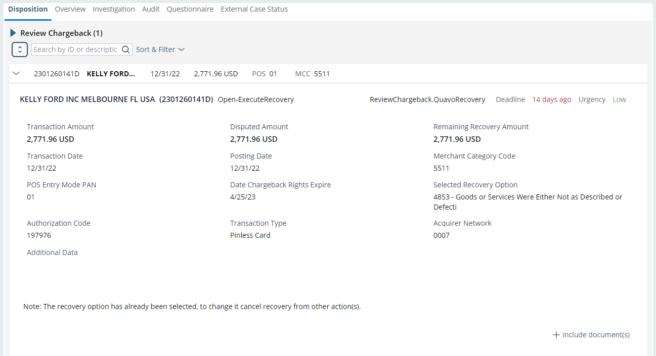
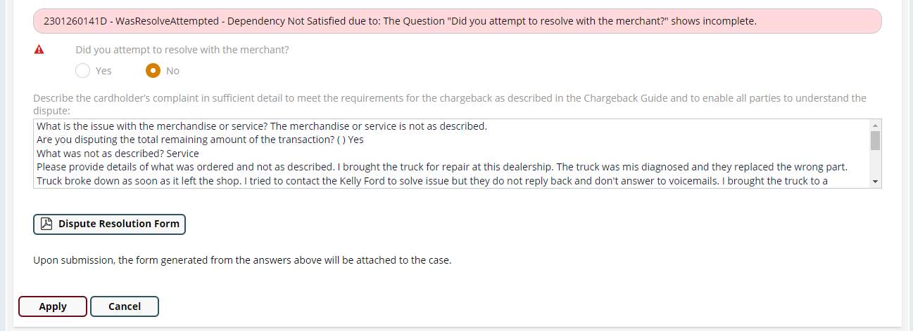
REVIEW CHARGEBACK
EXAMPLE
Review the chargeback form error.
Take the appropriate action to resolve the error such as correcting the response to the intake form or pending the dispute to request additional information from the accountholder.
Click the Apply button.
Click the Process Actions button.

Slide 35

REVIEW DISPUTE RESPONSE
HOW TO
The Review Dispute Response assignment is generated when the merchant declines the dispute or accepts partial liability.
We’ll review the claim and determine the next step: pay the claim, deny the claim or deny the merchant’s assertion.
Goal: Pay or deny the claim or decline the merchant’s assertion (representment/pre-arbitration).

Slide 36
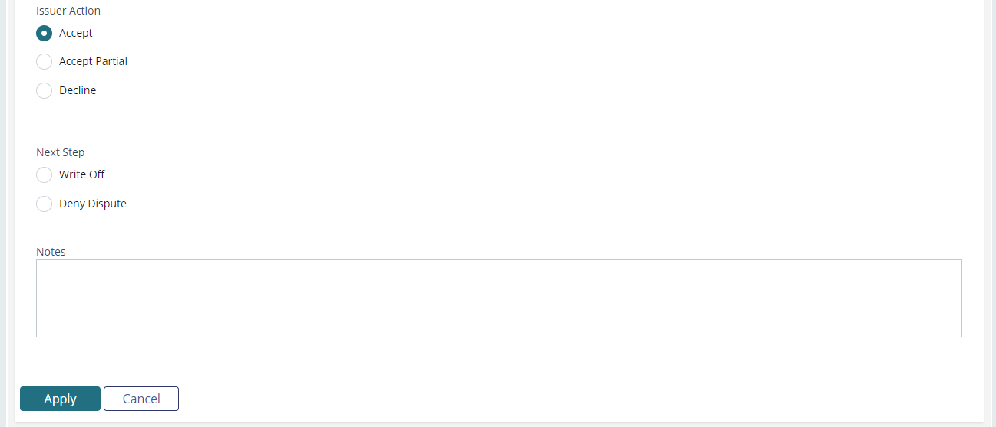
REVIEW DISPUTE RESPONSE
EXAMPLE I: ACCEPT
Select the Accept option.
Select Write Off to pay the dispute. Select Deny Dispute to deny the dispute.
Optional: Add your decision reasoning to the Notes field.
Click the Apply button.
Click the Process Actions button.

Slide 37
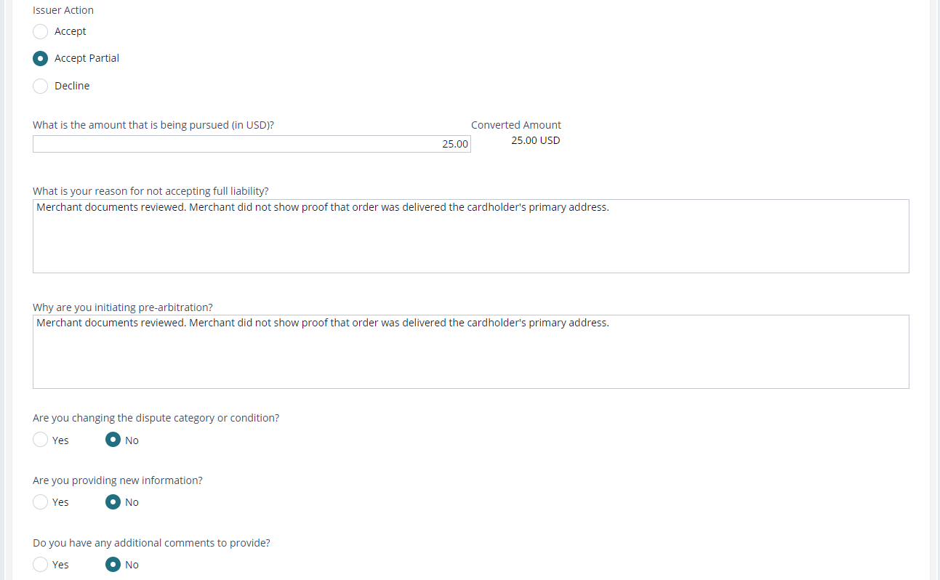
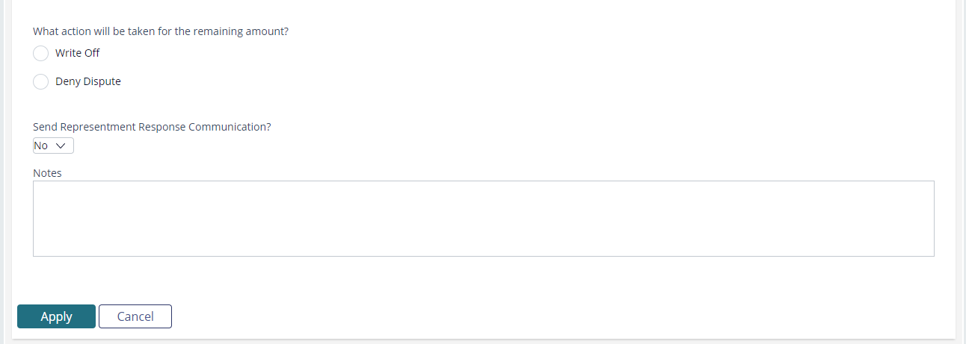


REVIEW DISPUTE RESPONSE
EXAMPLE II: ACCEPT PARTIAL
Select the Accept Partial option.
Enter the amount that was not accepted by the merchant.
Explain the reason for not accepting full liability and why you’re initiating pre-arbitration in the respective fields.
Select Write Off to pay the dispute. Select Deny Dispute to deny the dispute.
Determine if you’ll send the Representment Response to the cardholder.
Click the Apply button.
Click the Process Actions button.

Slide 38
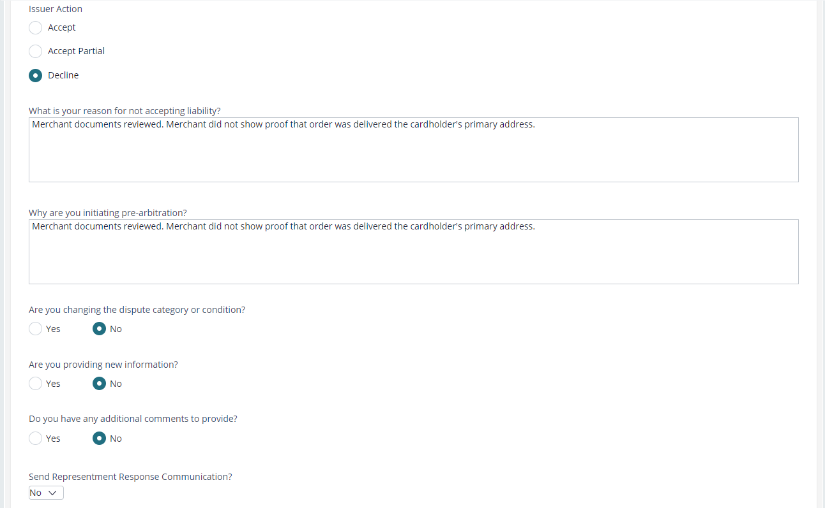
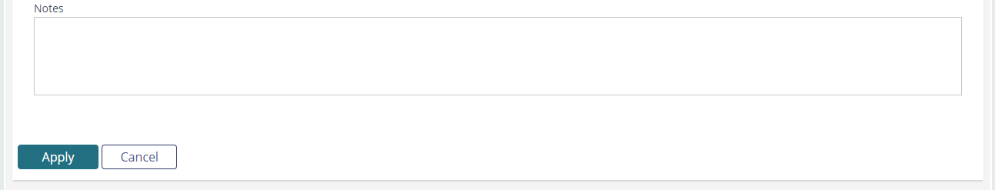
REVIEW DISPUTE RESPONSE
EXAMPLE III: DECLINE
Select the Decline option.
Explain the reason for not accepting full liability and why you’re initiating pre-arbitration in the respective fields.
Answer the questions accordingly.
Determine if you’ll send the Representment Response to the cardholder.
Optional: Add your decision reasoning to the Notes field.
Click the Apply button.
Click the Process Actions button.

Slide 39

PROCESS LIABILITY
HOW TO
The Process Liability assignment is generated when all recovery options have been exhausted or recovery options do not exist for the disputed charge.
We’ll review the claim and determine if the claim should be paid or denied.
Goal: Pay or deny the claim.

Slide 40
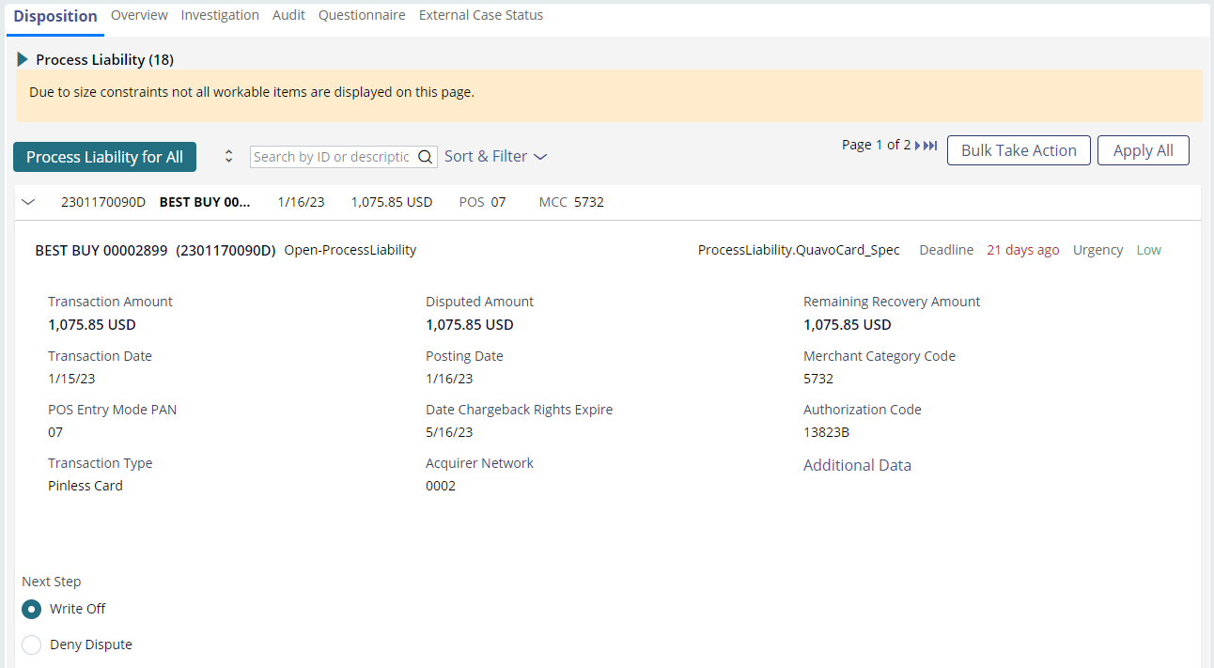
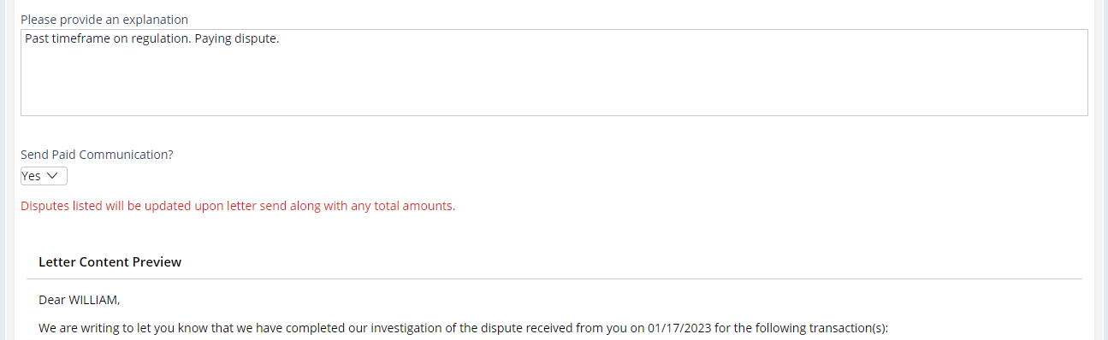
PROCESS LIABILITY
EXAMPLE I: PAY
Select the Write Off option.
Explain the reason for paying the dispute in the explanation field.
Click the Apply button.
Click the Process Actions button.

Slide 41
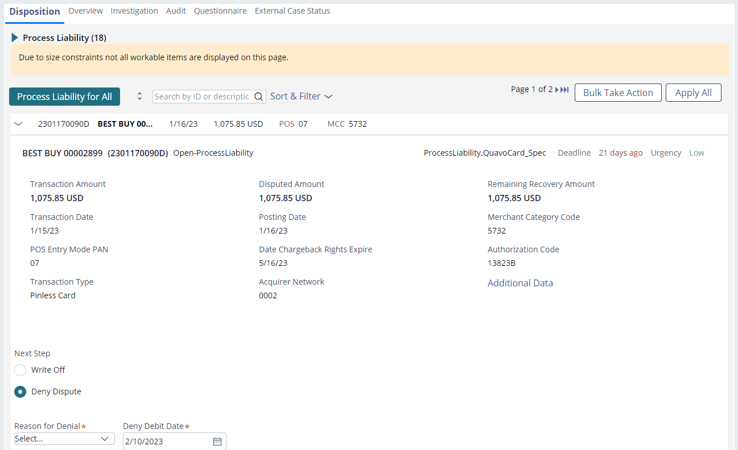
PROCESS LIABILITY
EXAMPLE II: DENY
Select the Deny Dispute option.
Select the deny reason from the Reason for Denial drop-down.
Ensure the deny debit date is compliant.
Optional: Add your decision reasoning to the Deny Comments field.
Click the Apply button.
Click the Process Actions button.

Slide 42
responses

Slide 43

INBOUND COMMUNICATION
DETAILS
The Responses node houses many assignments that involve communication with the accountholder or front-office specialists.
In this section, we’ll cover the inbound communication assignments:
Read New Correspondence
Review New Attachment
Review Re-open Request
Review Withdrawal Request

Slide 44

READ NEW CORRESPONDENCE
HOW TO
We need to review the accountholder’s email to us so that we can provide requested information or take appropriate action.
The Read New Corr assignment will prompt us to read the accountholder’s email to us.
Goal: Read the accountholder’s email and take the appropriate action.

Slide 45
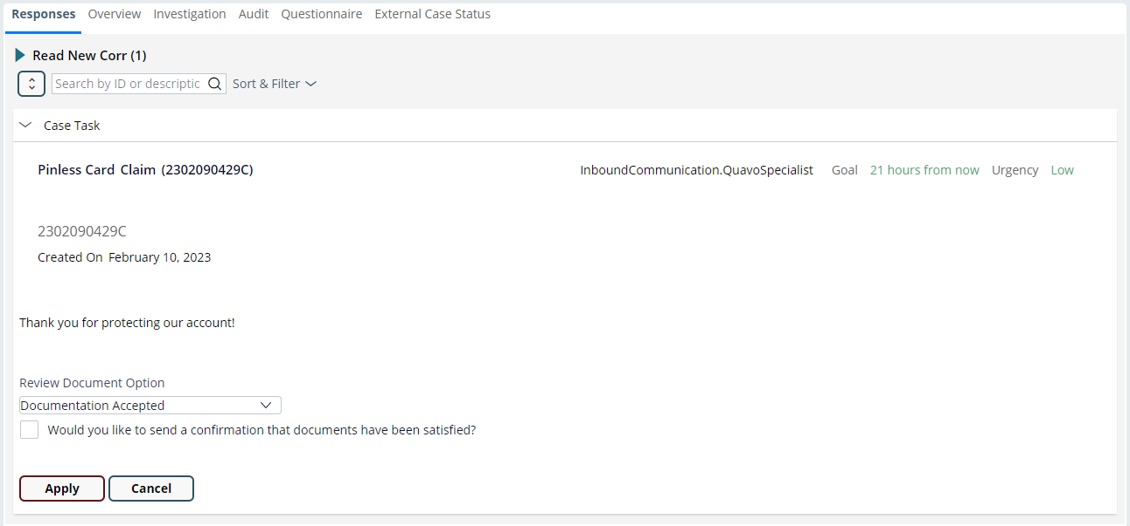
READ NEW CORRESPONDENCE
EXAMPLE I: ACCEPT DOCUMENTATION
Select the Documentation Accepted option from the Review Document Option drop-down.
Click the Apply button.
Determine if you’ll send an email confirming the correspondence has been received.
Click the Process Actions button.

Slide 46
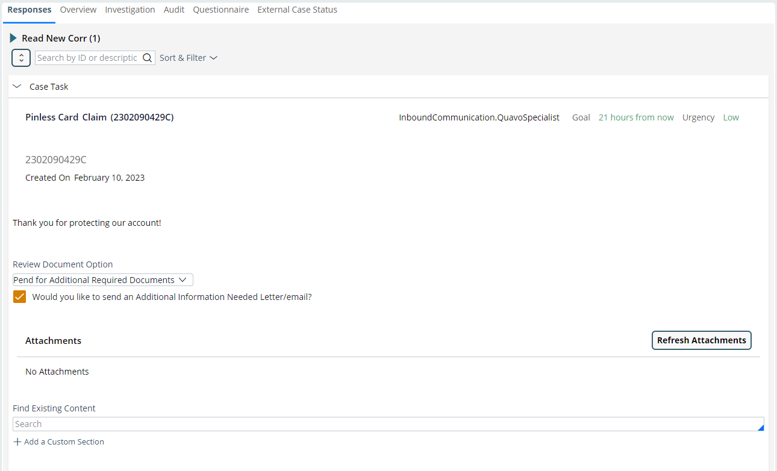
READ NEW CORRESPONDENCE
EXAMPLE II: PEND FOR ADDITIONAL DOCS
Select the Pend for Additional Required Documents from the Review Document Option drop-down.
If you decide to send an Additional Information Needed letter/email, select the required information.
Click the Apply button.
Click the Process Actions button.

Slide 47
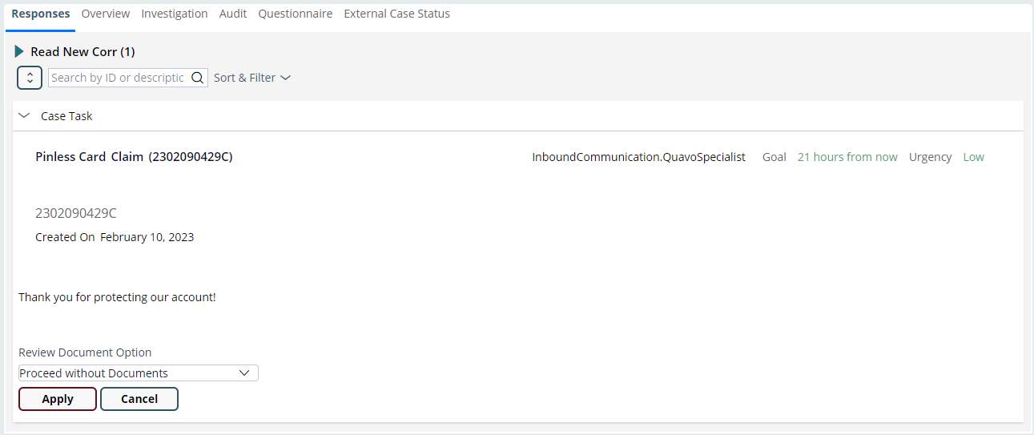
READ NEW CORRESPONDENCE
EXAMPLE III: PROCEED WITHOUT DOCS
Select the Proceed without Documents option from the Review Document Option drop-down.
Click the Apply button.
Click the Process Actions button.

Slide 48

REVIEW NEW ATTACHMENT
HOW TO
Front-office specialists and the accountholder may provide information or submit an attachment to the claim.
The Review New Attachment assignment will prompt us to review the new attachment.
Goal: Read the message and take the appropriate action.

Slide 49
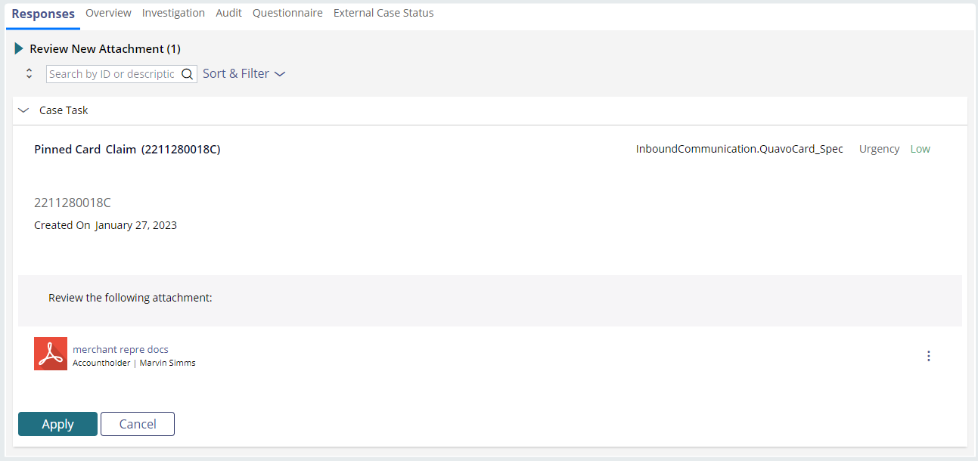
REVIEW NEW ATTACHMENT
EXAMPLE
Click the document link to open the attachment and review its contents.
Click the Process Actions button.
Click the Apply button.
Take the appropriate action based on the document provided.

Slide 50

REVIEW RE-OPEN REQUEST
HOW TO
The accountholder may want to re-open their denied claim if they disagree with the denial.
The Review Re-open Request assignment will prompt us to review the accountholder’s request.
Goal: Review the re-open request and determine if we should re-open the claim.

Slide 51
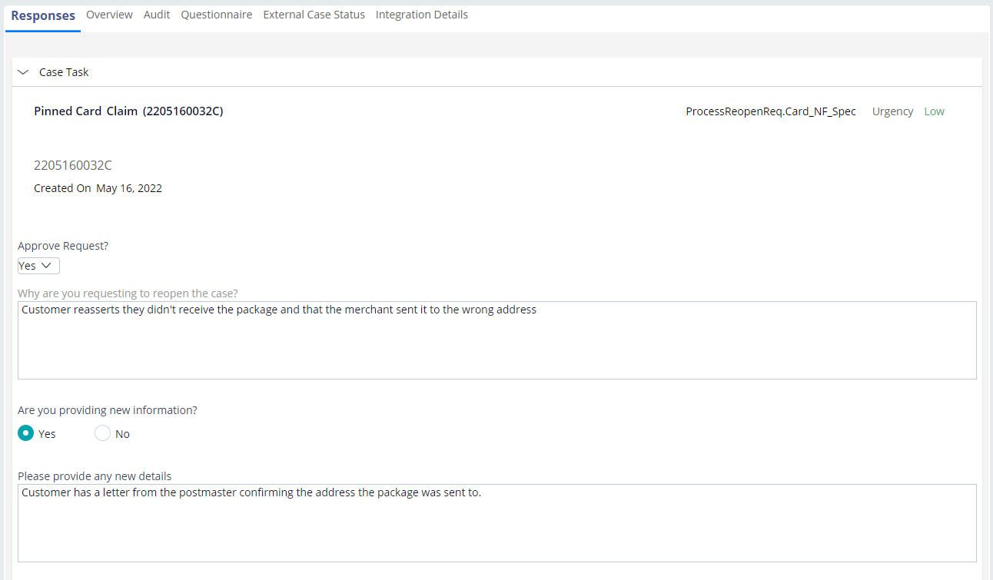
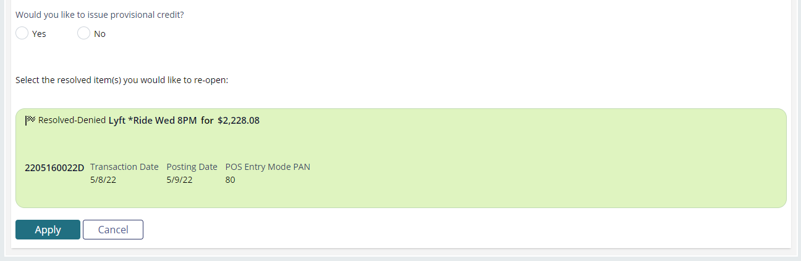
REVIEW RE-OPEN REQUEST
EXAMPLE I: APPROVE REQUEST
Select the Yes option under the Approve Request drop-down.
Answer the questions that generate if they don’t already have responses.
Determine if provisional credit should be issued.
Click the Apply button.
Click the Process Actions button.

Slide 52
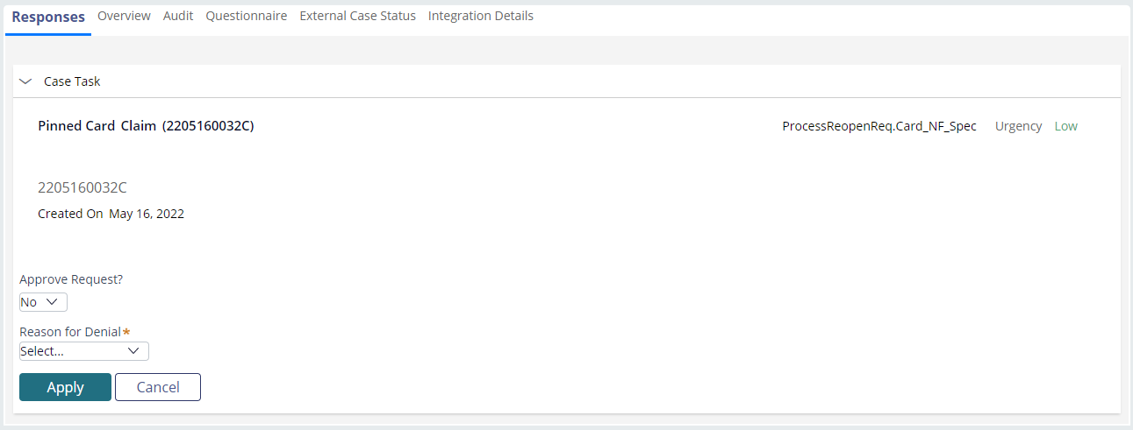
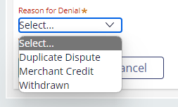
REVIEW RE-OPEN REQUEST
EXAMPLE I: DENY REQUEST
Select the No option under the Approve Request drop-down.
Select the reason for denying the re-open request from the Reason for Denial drop-down.
Review the deny letter if you decide to send one.
Click the Apply button.
Click the Process Actions button.

Slide 53

REVIEW WITHDRAW REQUEST
HOW TO
Front-office specialists and the accountholder may request to close out the claim for a variety of reasons.
The Review Withdraw Request assignment will prompt us to process the withdraw request.
Goal: Review the withdraw request and take the appropriate action.

Slide 54
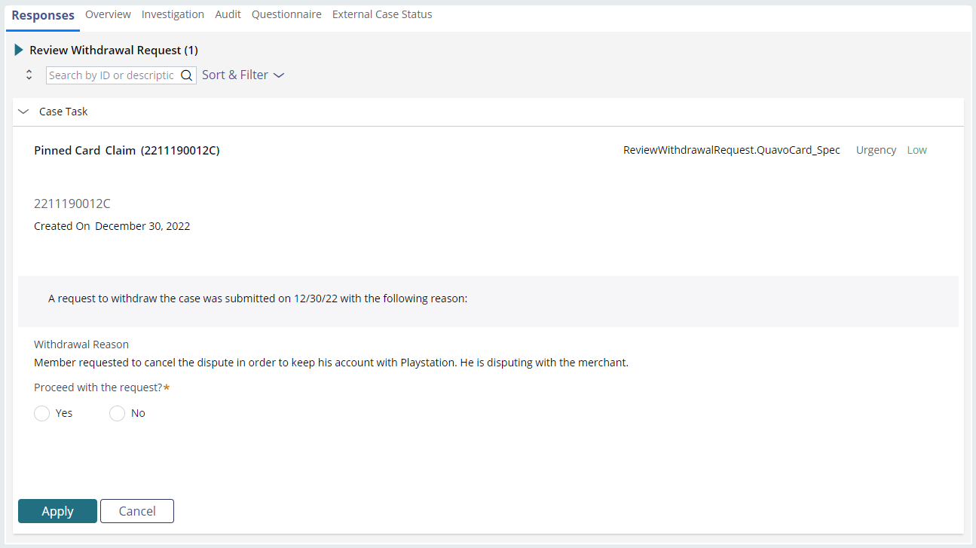
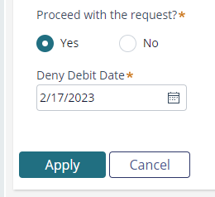
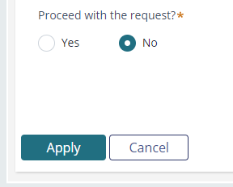
REVIEW WITHDRAW REQUEST
EXAMPLE
Review the Withdrawal Reason.
Select Yes under Proceed with the Request to close out the claim and deny the dispute.
Select No under Proceed with the Request to deny the withdrawal request and resume claim work.
Click the Apply button.
Click the Process Actions button.

